Slide 1
Economics Intro
Vocab Exercise

Slide 2
Example
Needs
A need is something that is necessary for an organism to survive.
Needs are distinguished from wants. A want is a desire, wish or aspiration.
According to Abraham Maslow, food belongs to the basic needs.

Slide 3
Example
Resources or factors of production
Resources are used to produce goods and services.
Resources are also known as factors of production (land, labor, capital, information, innovation)
Because we only have one planet and resources are limited, we have to live sustainably.

Slide 4
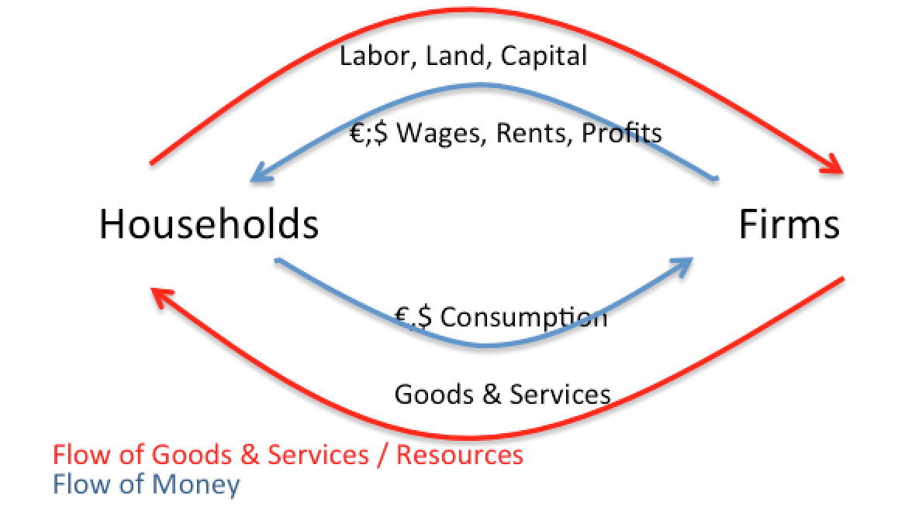
Example
Circular flow model
The basic circular flow model of the economy is a simple visualisation of the key elements of economic transactions.
It consists of households and firms, the flows of goods and services and the flow of money.
The simple circular flow model can be expanded by banks, the state and other countries.

Slide 5
Example
Division of labor
Division of labor is the separation of tasks in an economic system so that the participants in this system can specialize.
Division of labor is the origin of our modern professions.
According to the economist Adam Smith, the degree of division of labor in a society is one of the most important contributers to the wealth of nations.

Slide 6
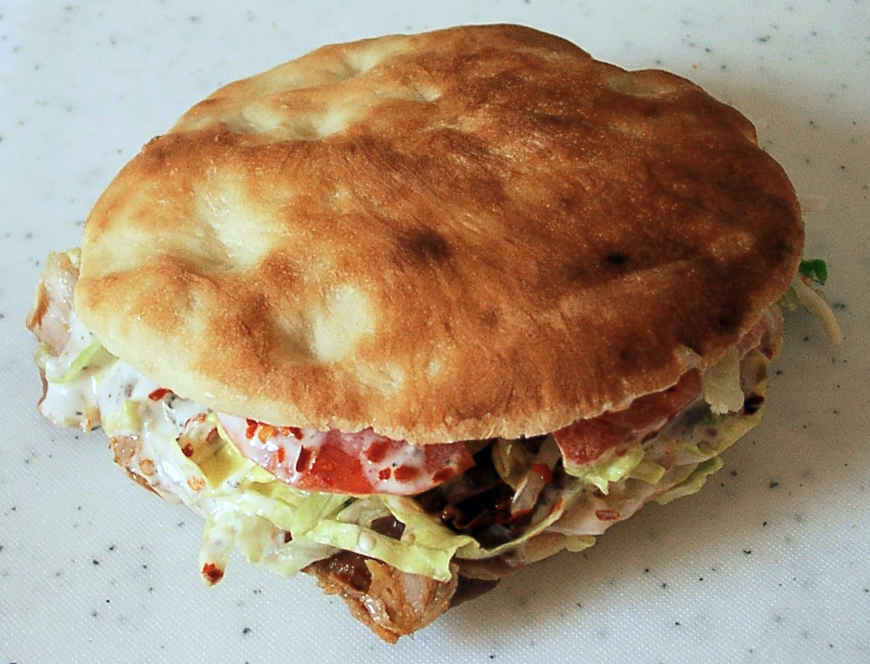
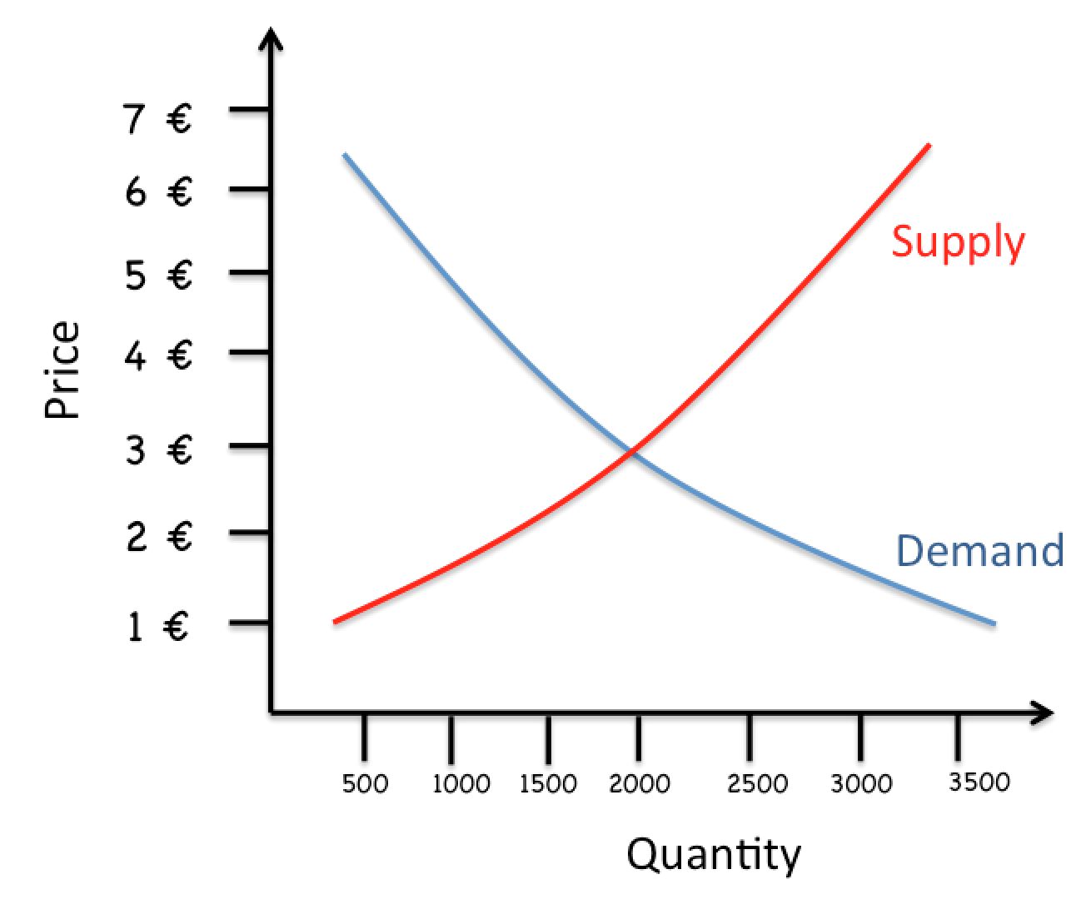
Example
Market model
A market model is used to visualize how the forces of demand and supply interact and determine prices and quantities sold on a market.
In a market model you can see the equilibrium (where demand curve and supply curve meet).
The market model is one of the most important models in Economics. However it is often criticised.

Slide 7
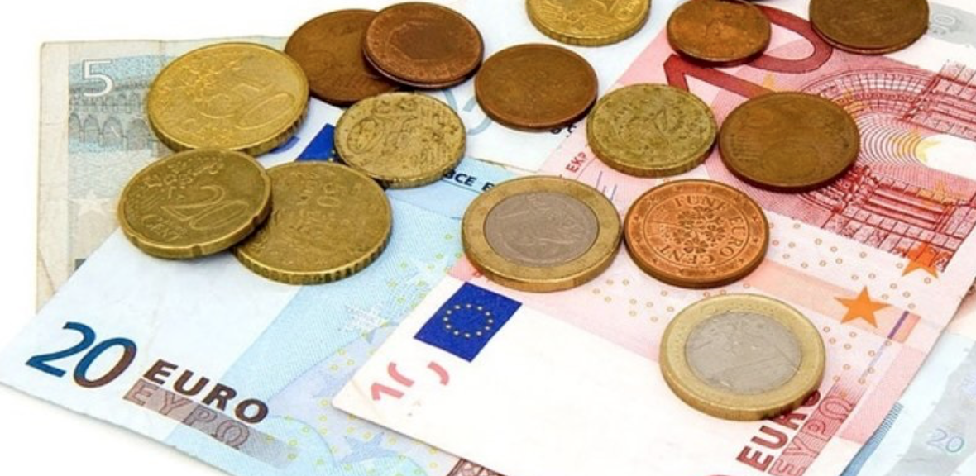
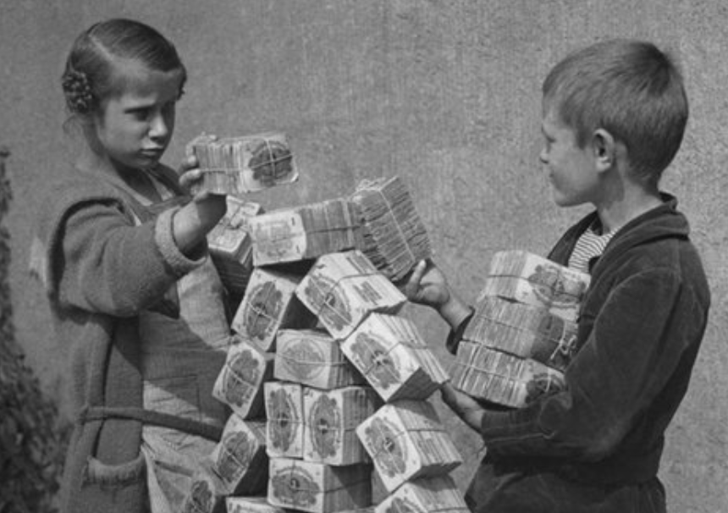
Example
Money
Money is everything you can use for payments.
The functions of money include
Means of exchange
Preservation of value
Calculations
Use for financing
Inflation is .... when money loses value (its buying power).

Slide 8
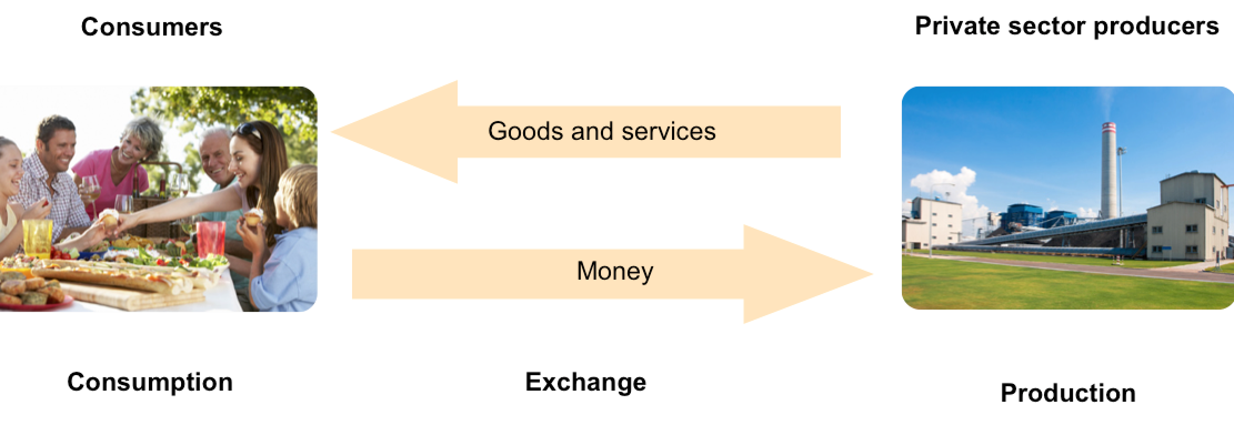
Economic Systems: Free Market Economy
In a free market economic system all decisions are taken by private sector organisations.
Example
In a free market system the role for the government is very limited; it only provides the frame.

Slide 9
Economic Systems: Free Market Economy
In a free market economic system all decisions are taken by private sector organisations.
Example
In a free market system the role for the government is very limited, it only provides the frame.

Slide 10
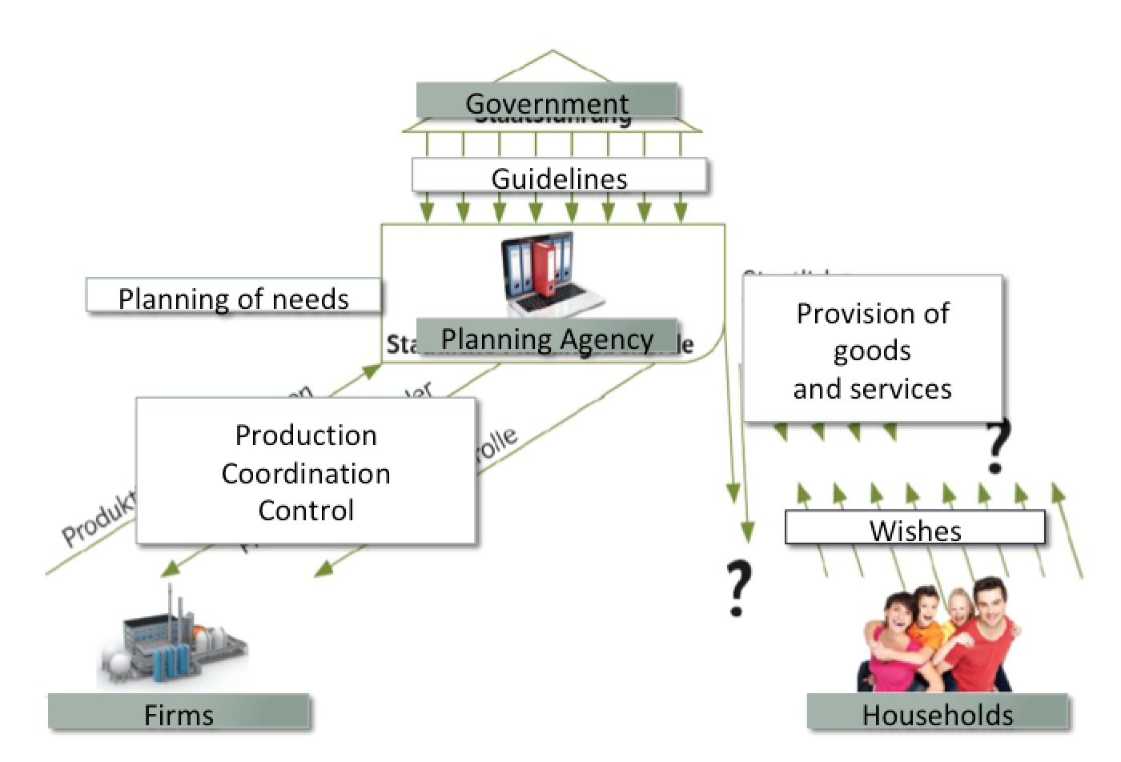
Economic Systems: Planned economic system
In a planned economy, the state makes most decisions about who produces what for whom and about the distribution of income, resources and ownership of machines.
Example
Since the 1990s, the governments of many planned economies (China, Russia) have introduced policies that have increased the role of the market economic system in their economies.

Slide 11
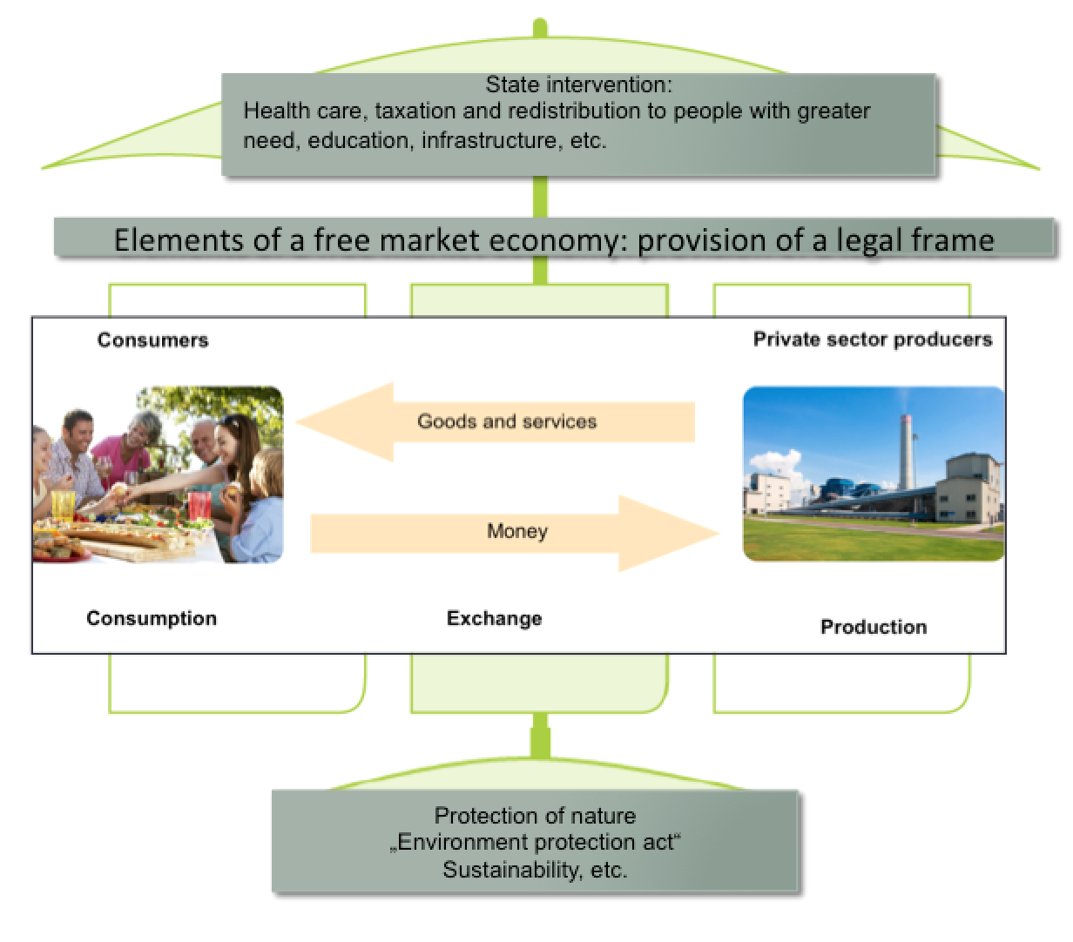
Economic Systems: mixed systems
In reality there are no totally free market or planned economies.
Example
One example for a mixed economy is the eco-social market economy. However, the ecological aspects need a much stronger focus in future.

Slide 12
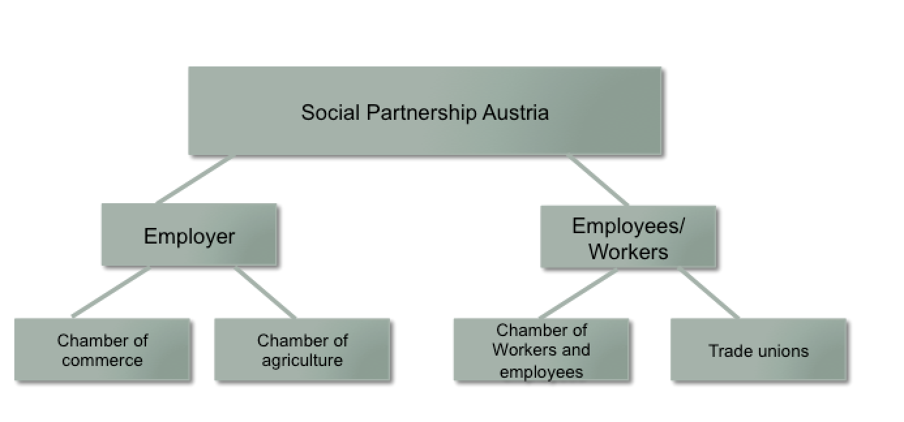
Social partnership
Social partnership (institutionalized cooperation between labor and business representative bodies) is an important instrument of the Austrian social market economy.
Example
Experts argue due to the social partnership, the level of strike action in Austria is extremely low, compared to other countries.

Slide 13
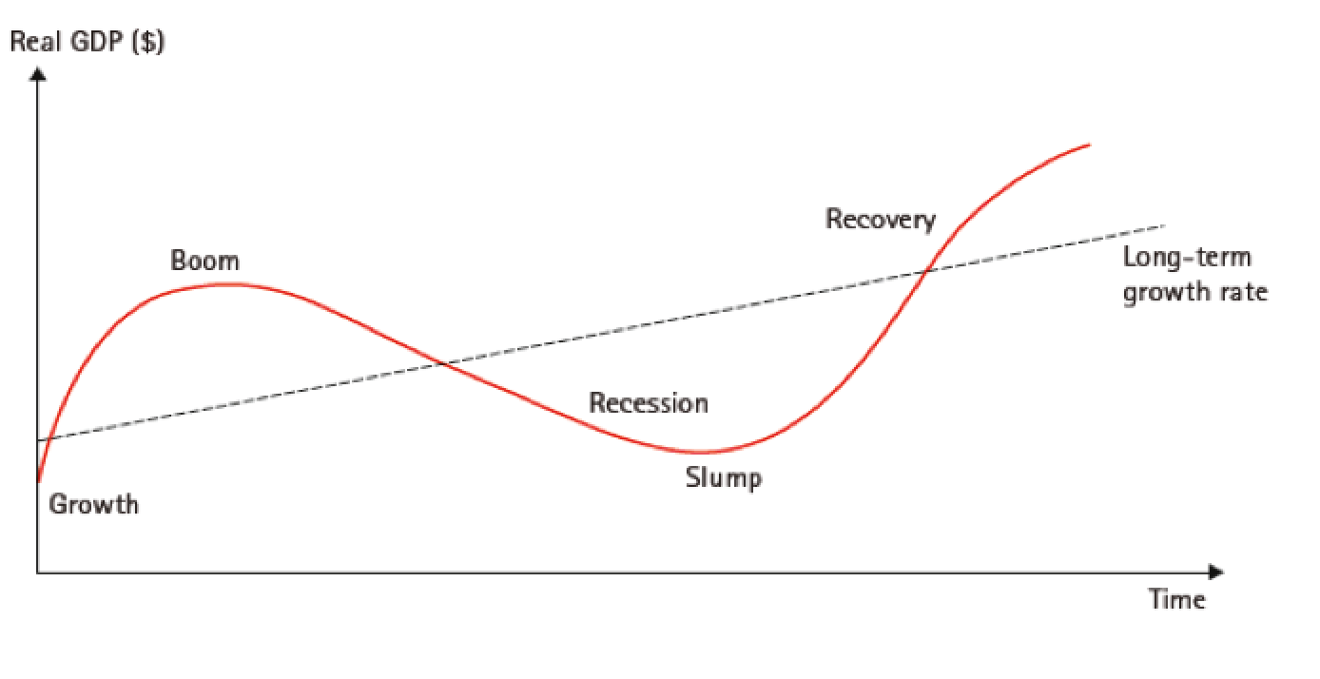
Business Cycle
The business cycle refers to the pattern of recurrent ups and downs (or cyclical fluctuations) in an economy.
Example
Real GDP (growth domestic product) is used to measure the ups and downs in an economy.

Slide 14
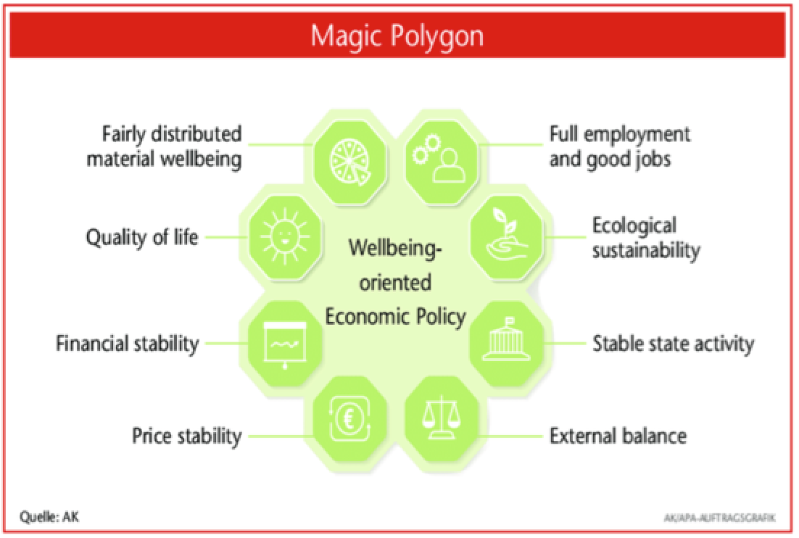
Goals of economic policy
Economic policy is the sum of all planned measures of the state and other institutions to stimulate the economy.
Example
It is very difficult to realize more than one economic goal at the same time.

