Slide 1
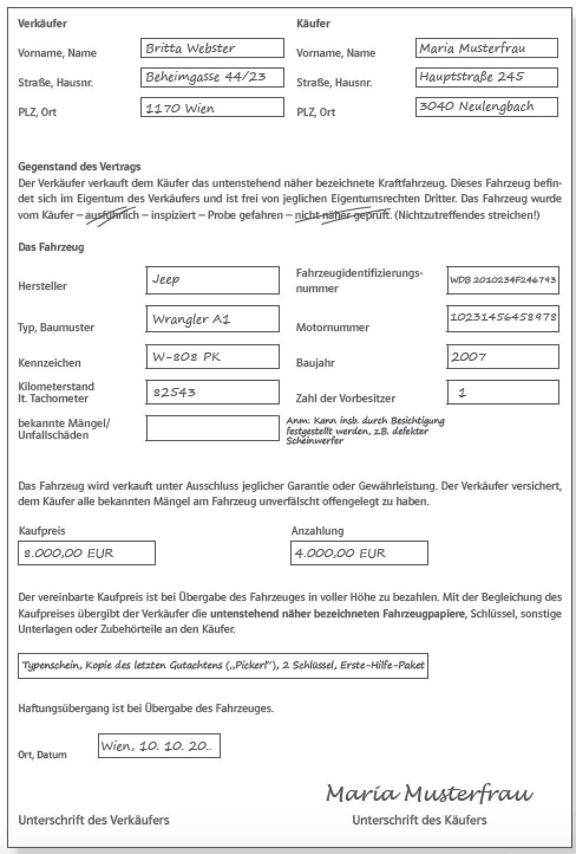
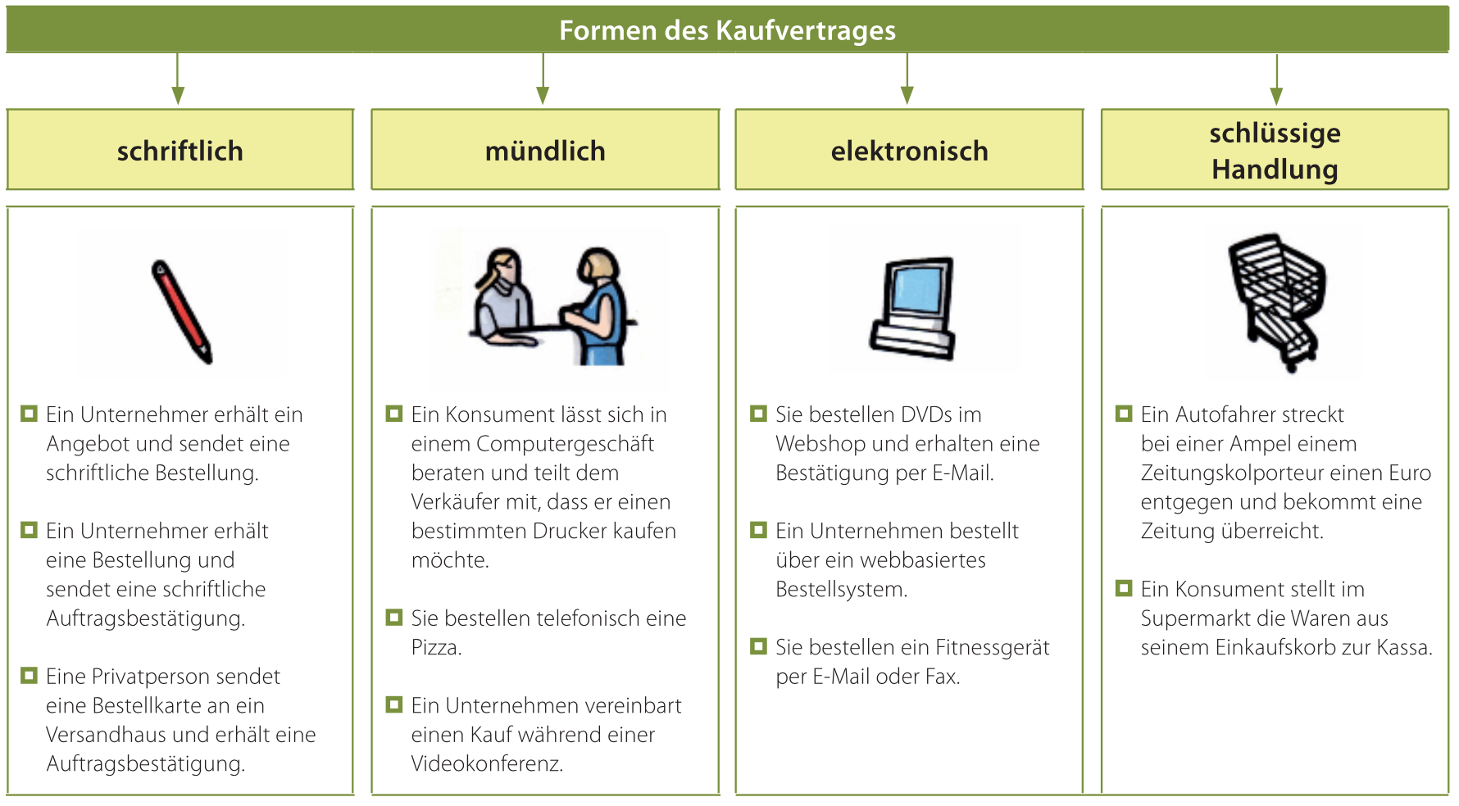
Sales Agreements Introduction
Goals/Competences: Explain prerequisites of sales contract , describe different forms of sales contracts, name the minimal elements of sales contracts
Prerequisits
Agreement of will
Legal capacity
True agreement
Possibility
Permitted
Forms
Written
Verbal
Electronic
through action
Minimum Elements
Seller
Buyer
Quality
Quantity
Price
Phases of conclusion
Initiation
Closure
Fulfillment
Prerequisits of sales contracts
2) Legal Capacity by age:
Persons under 7 years of age (children) completely incapable of contracting - Typical purchases for this age group (so-called "pocket money transactions" - e.g. purchase of sausage sandwiches, sweets, movie ticket)
Persons between the ages of 7 and 14 (minors) have limited legal capacity - Typical purchases for this age group without parental consent - so-called "pocket money transactions" (e.g. purchase of books or CDs)
- Accepting gifts, if these are not connected with further obligations
Persons between 14 and 18 years of age (mature minors) limited legal capacity - Make typical purchases for this age group without parental consent - so-called "pocket money transactions" (e.g. order to repair bicycle)
- Take on smaller jobs, such as babysitting, shopping for money, etc., as long as school performance does not suffer as a result
- Dispose freely of income from their own earnings (e.g., apprenticeship compensation)
- Dispose freely of property left at their disposal (e.g. pocket money).
- Under certain conditions, conclude a rental agreement
Persons over the age of 18 have full legal capacity - among other things, they can independently conclude various contracts.
1 Agreement of will
2 legal capacity
3 true agreement
4 Possibility
5 Permitted
Other prerequisits
3) True agreement
e.g. Under coercion no contract can be concluded
4) Possibility:
E.g. sale of a time machine is impossible
5) Permitted:
e.g. sale of drugs is illegal
1) Agreement of will … boch parties mean the same
Phases of Sales Agreements
1) Initiation
Promotion: Brochures
Inquiry: info procurement
...non-binding, verbally / in writing
2) Conclusion:
a) offer: reason / binding
G: 1 requested / 2 unsolicited
V: 3 binding / 4 non-binding
Non-binding: similar to offer, ...
Condition for binding:
Certain seller
Specified buyer
Quantity
Type
Price
Binding intention recognizable
Must be received
Commitment period: according to offer or if not stated by law
verbal: duration of conversation
Written double post + reasonable consideration
Exemption clauses
- Without obligation, without engagement,...
b) Order,
c) order confirmation
3) Fulfillment
Delivery (delivery bill)
Invoice + payment
Translated with www.DeepL.com/Translator (free version)
How are sales agreements concluded, which forms are pssible?
Minimum Elementw
If one element is missing, there is no valid sales contract
1) buyer
2) Seller
3) Quality / type
4) Quantity
5) price
Agreement of will by
1 Binding offer + order
2 Order and order confirmation
3 Order and delivery

