Slide 1
Idea Challenge / B1: Entrepreneurial Design – a sustainable business model
Idea Challenge B1
I can develop an idea and a model how to implement it.
Core Entrepreneurial Education
Entrepreneurial Design – a sustainable business model

Slide 2
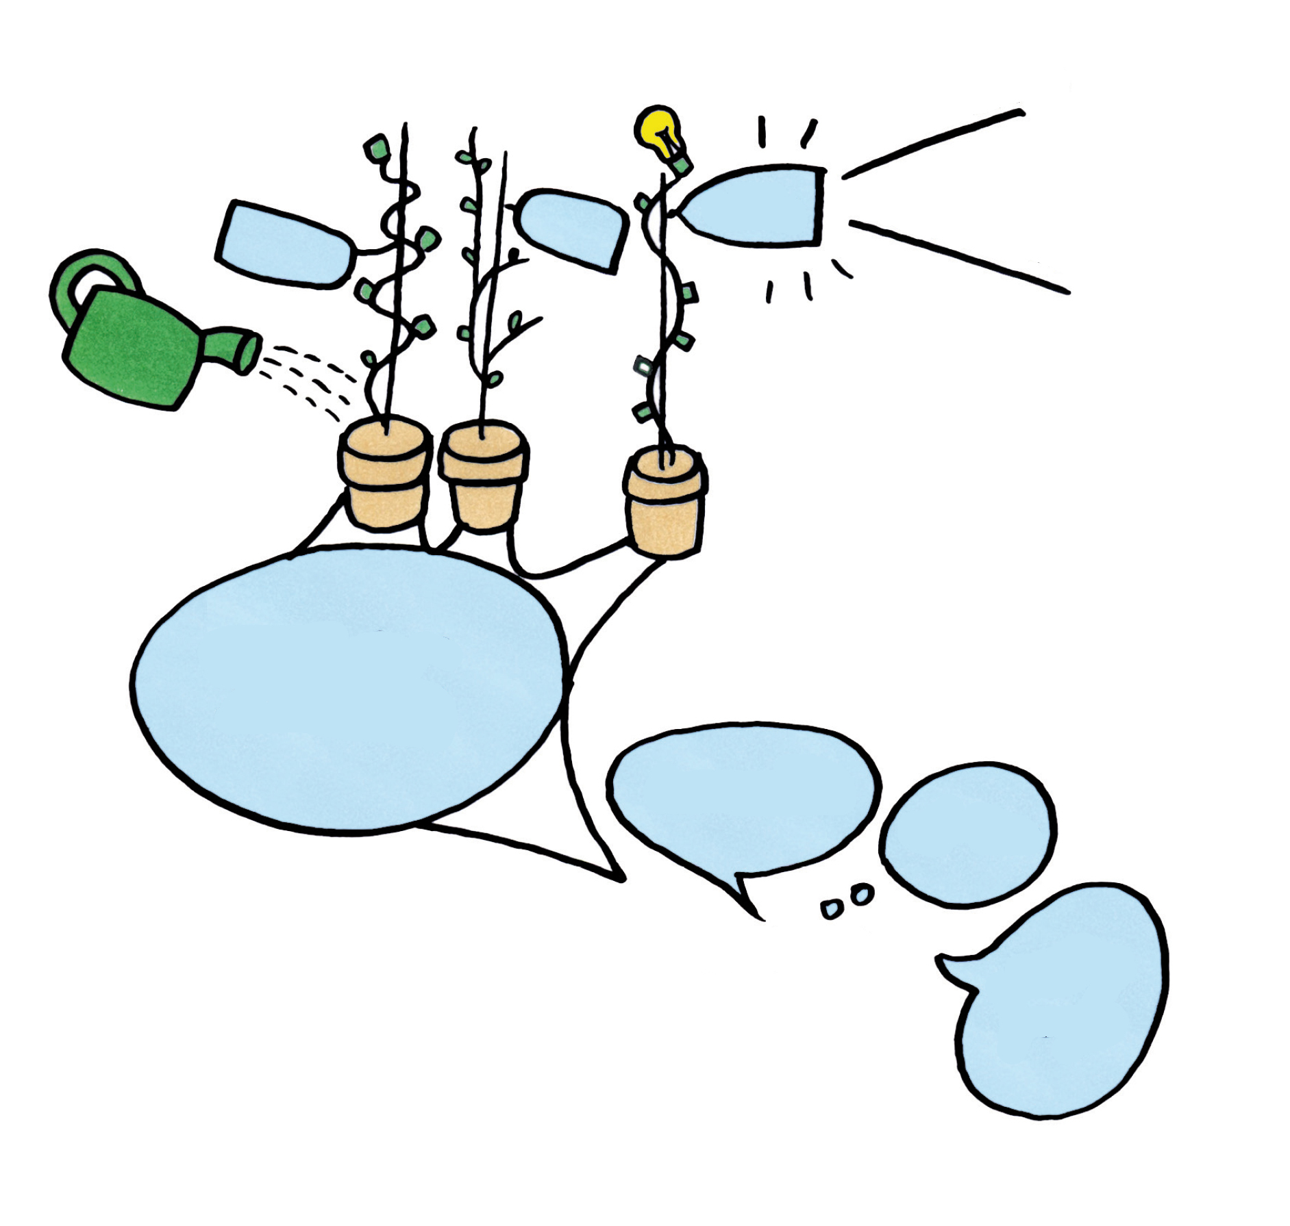
Trading Game
Demand
Idea
Market opportunity
Secrets of
success
Friendliness
Listening
Communication
Enquiring
Illustration: Helmut Pokornig

Slide 3
Activity
Do you like using your
Imagination?
Look at the different image
details in the circles.
Think about about what those
images might represent and
share it your classmates. You
will be surprised that your
friends may have similar
perceptions.
Let your ideas flow.
Illustration: Helmut Pokornig

Slide 4
Playing with colour a) Read each word out loud
Blue
Green
Yellow
Yellow
Red
Green
Red
Blue
Red
Green
Yellow
Blue

Slide 5
b) Say the name of each colour out loud. What is going on inside your head?
Blue
Green
Yellow
Yellow
Red
Green
Red
Blue
Red
Green
Yellow
Blue

Slide 6
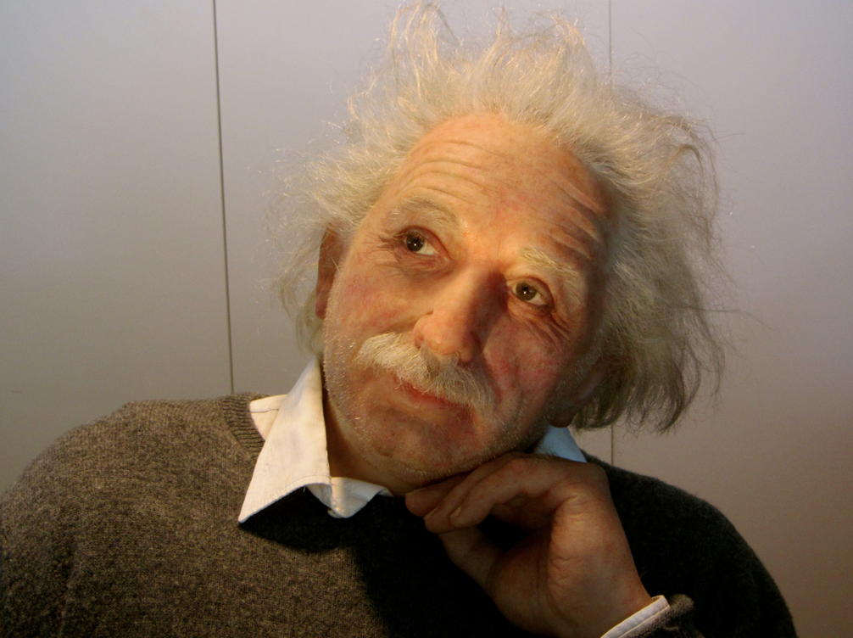
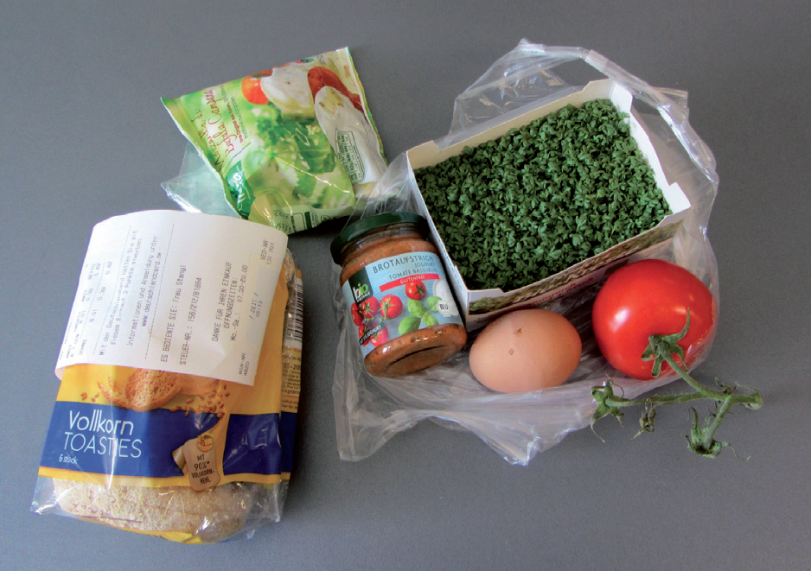
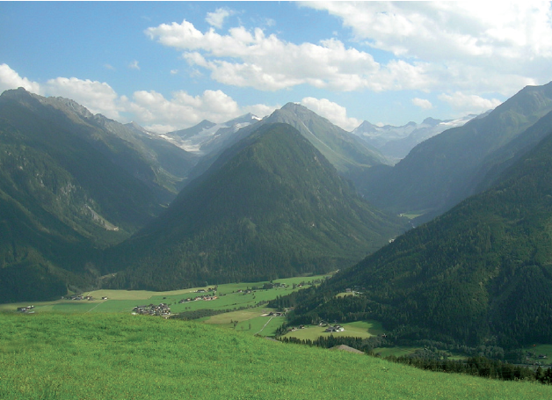
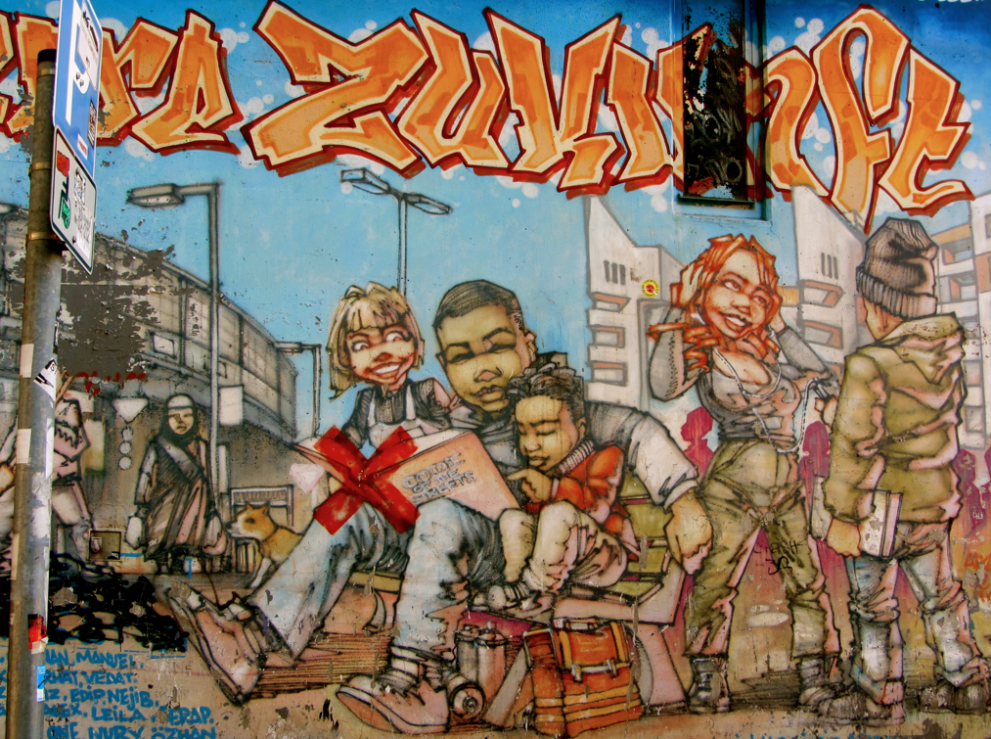
Pictures to inspire creative ideas
Fotos: Johannes Lindner

Slide 7
Idea Canvas
Check an Opportunity
The person is the catalyst:
Dream comes to life
Hobby becomes a job
internal
Check market
opportunity
Identify your target group
Conduct market research
to clarify market chances
and more information
about the target group.
Practitioner Evaluation
Market Research
Develop an (Business-) Idea
The market opportunity
is the catalyst:
Become aware of a problem e.g. environment pollution, social problem
Change e.g. law, trend
Technical development e.g. Internet, Smart-Phones
Competition
Solve a problem
Discover the existing
Combination
Against the grain
User innovation /
Open innovation
Imitation: franchising,
takeover
external
Source: Lindner, J./Fröhlich, G (2015): Wirtschaft gestalten

Slide 8
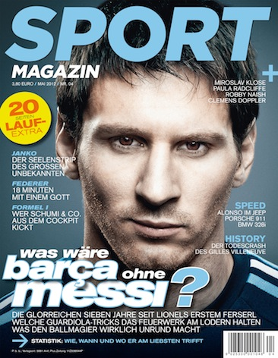
Develop a Business Idea - Internal
Dream
comes to life
Lionel Messi
Source Sportmagazin

Slide 9
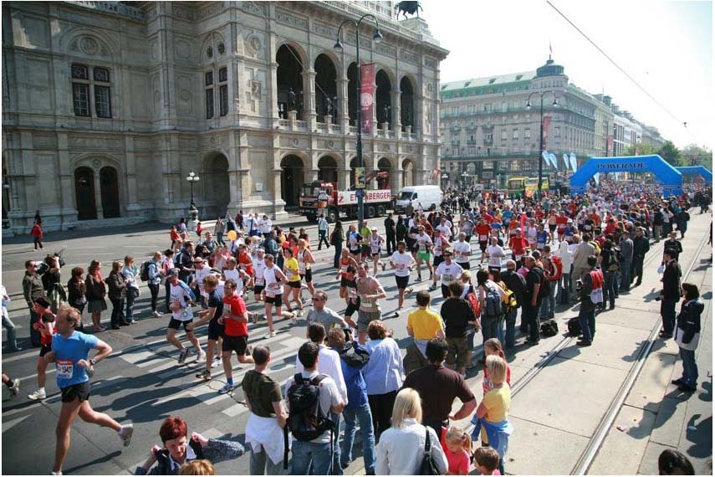
Develop a Business Idea - Internal
A hobby becomes a job
Vienna City Marathon
Source VCM / Niki Wagner

Slide 10
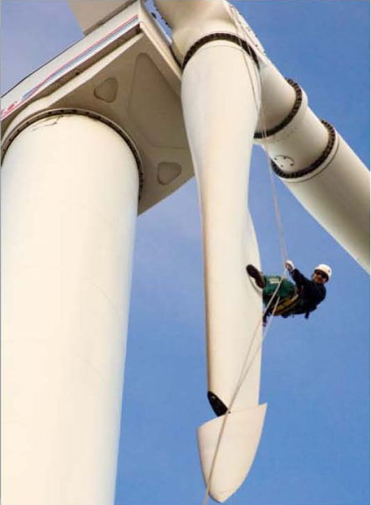
Develop a Business Idea - External
Solve a problem
Source Paul Langrock / Angentur für Erneuerbare Energie

Slide 11
Develop a Business Idea - External
Transform an
existing idea
Source: Red Bull Contentpool

Slide 12
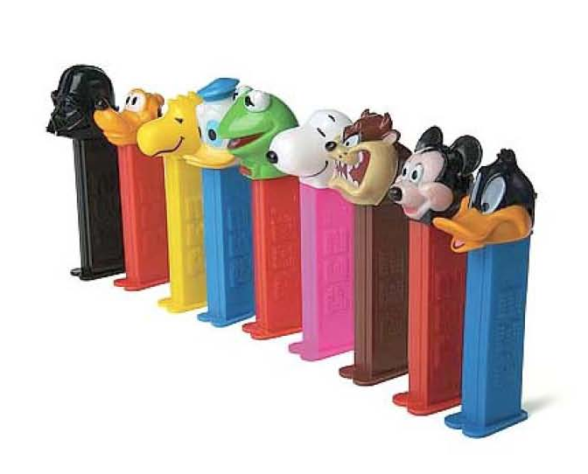
Develop a Business Idea - External
A combination
of ideas
Source: TM & PEZ AG

Slide 13
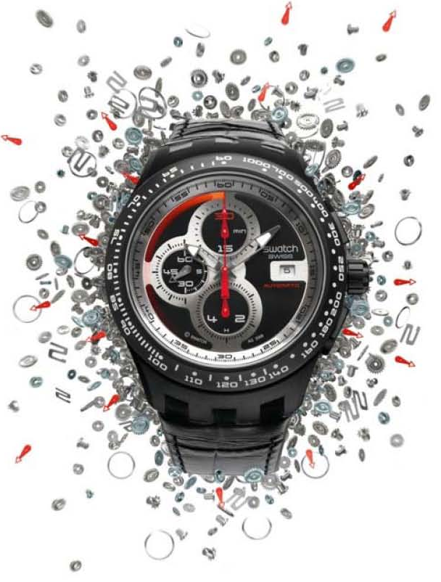
Develop a Business Idea - External
Going against
the grain
Automatic Chronos
Source: The Swatch Group (Austria)

Slide 14
Develop a Business Idea - External
User Innovation Open Innovation
Source Wikimedia Foundation

Slide 15
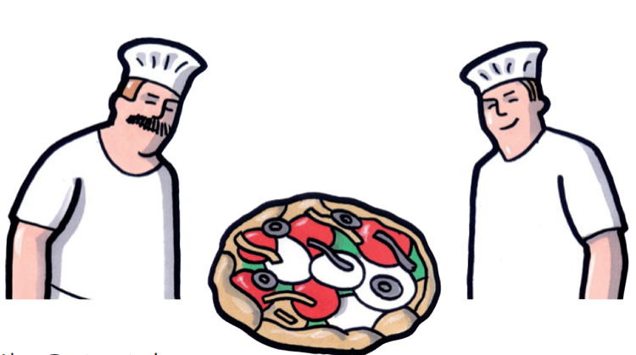
Develop a Business Idea - External
Imitation
Illustration: Helmut Pokornig

Slide 16
Develop a Business Idea - External
Franchising
Bio-Racal, „children´s brand“
Source Sonnentor Kräuterhandel GmbH

Slide 17
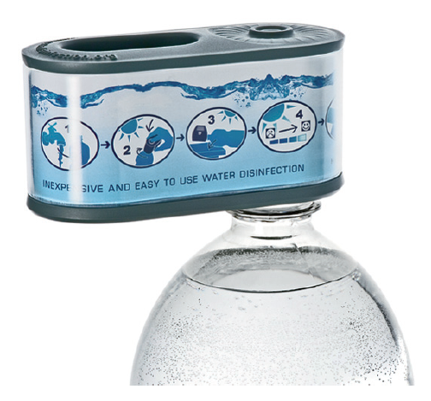
Analyse a Business Idea and its Chances
17
17
17
Source Matin Wesian
Source Helmut Pokornig

Slide 18
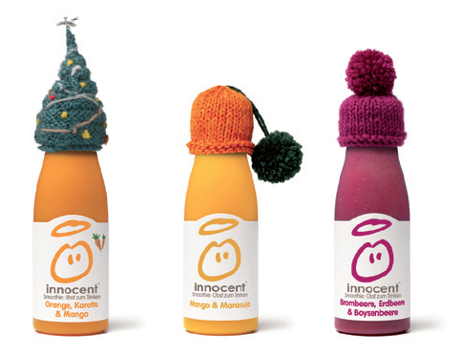
Analyse a Business Idea and its Chances
18
18
18
Source innocent Alps Gmbh

Slide 19
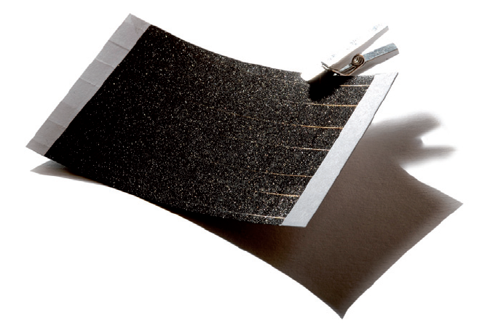
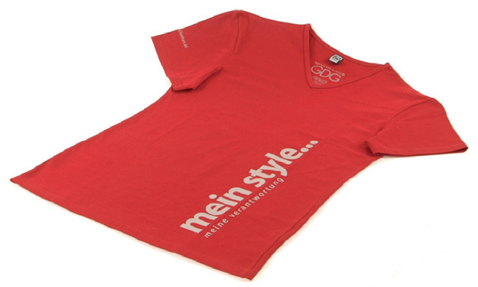
Analyse a Business Idea and its Chances
19
19
19
Source crystalsol GmbH
Source Göttin des Glücks

Slide 20
Analyse a Business Idea and its Chances
20
20
20
Source Nina Dautzenberg / Andrea Gaesmann

Slide 21
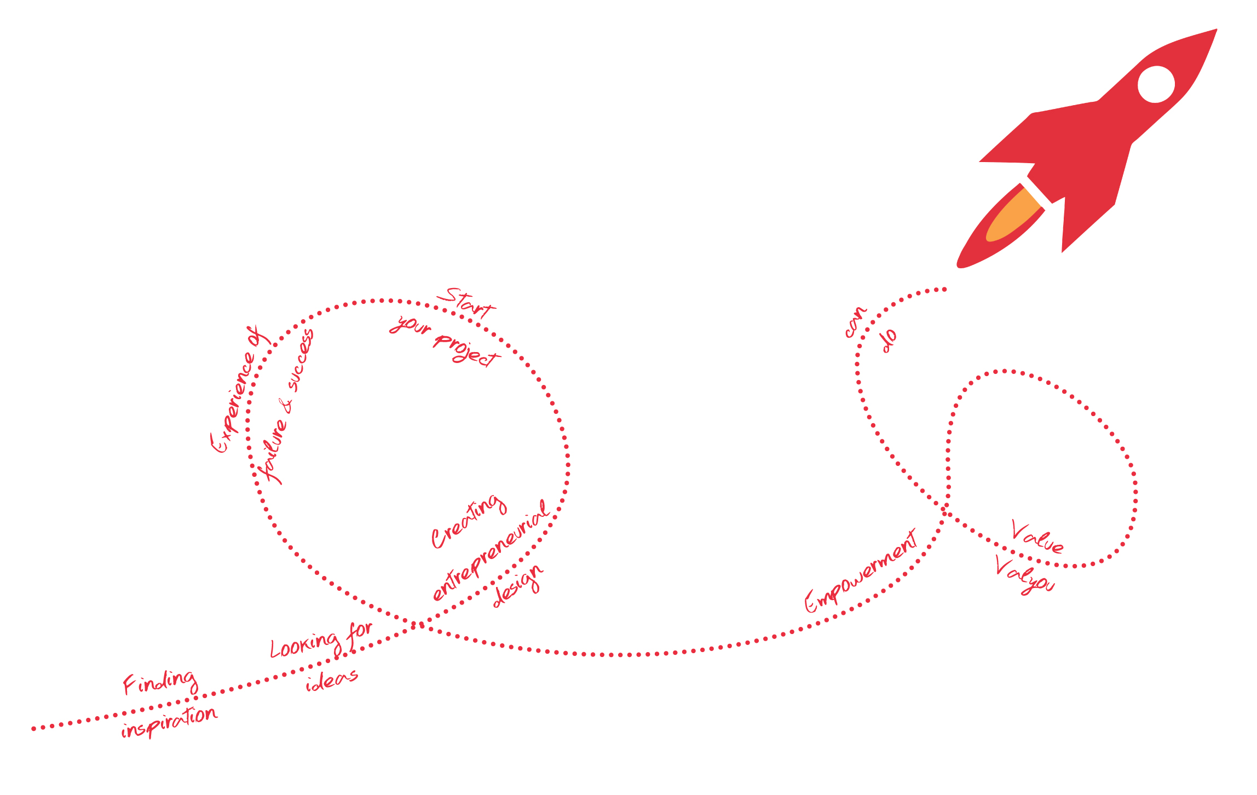
Source Johannes Lindner/Gerald Fröhlich (2014): Innovation Book,
Illustrators: Helmut Pokornig and Hermann Redlingshofer
Contact: office@ifte.at

