Slide 1
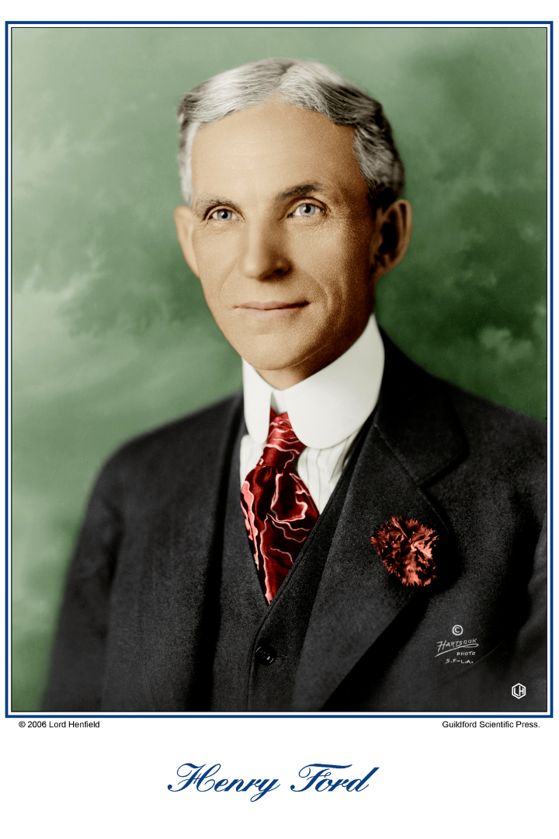
Portrait of Entrepreneur Henry Ford
Henry Ford was an American entrepreneur and inventor who founded Ford Motor Company. He was born on July 30, 1863, in Michigan and he built his first steam engine in 1878 at the age of 15.
by Werner Holzheu

Slide 2
Early Career
Apprenticeships 👨‍🏭
First Businesses 🔑
The Famous Model T 🚗
As a young man, Ford went through several apprenticeships, learning about mechanics, electrical engineering and machines.
In 1899, he established the Detroit Automobile Company but it was dissolved after only two years. In 1901, he created the Henry Ford Company, which was later renamed to Cadillac Automobile Company. However, a disagreement with investors forced him to leave the company a year later.
Finally, he founded Ford Motor Company in 1903 and introduced the Model T in 1908, one of the most significant technological innovations in automotive industry.

Slide 3
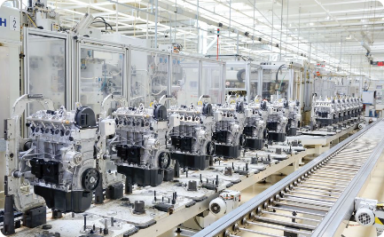
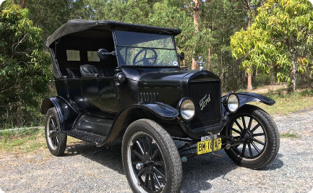
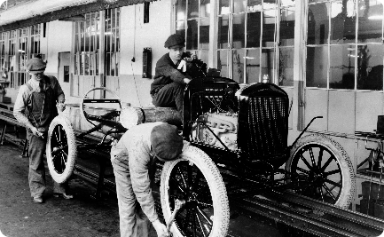
Visionary Business Idea
Assembly Line Manufacturing
Model T Car
Revolutionizing Industry
The Model T car was designed to be affordable for middle-class Americans, and its lightweight and easy-to-maintain design made it a best-seller.
By introducing and implementing the assembly line concept, Ford revolutionized the manufacturing industry and paved the way for modern mass production.
Ford was the first automaker to use a moving assembly line for car manufacturing, which increased production and significantly reduced labor costs.

Slide 4
The Problem Solved
1
Making Cars Accessible 🚗
Before Ford, cars were expensive and a luxury item affordable only by the upper class. The Model T offered a reliable car within the reach of the masses.
2
The Assembly Line 🏭
Prior to the assembly line manufacturing, cars were made by highly skilled craftsmen creating each part by hand, a slow and time-consuming process. Ford's method made car production much more efficient and faster.

Slide 5
Lessons from Failures
1
Detroit Automobile Company 🚘
Henry Ford's first major attempt at car manufacturing failed in 1901 due to poor financial skills and a lack of experience.
The Henry Ford Company 🔧
2
Ford left the company after only one year due to contractual disagreements. It was later renamed to Cadillac Automobile Company.
3
Decline in Business 💸
In the late 1920s, Ford faced criticism for not updating the Model T design and declining sales pushed the company to the brink of bankruptcy.
Rethinking and Innovating 🔍
4
Ford took steps to resolve the company's issues by creating new models and using innovative ideas. In 1932, he introduced a new car model, the Ford V-8 and sales quickly increased.

Slide 6
Impact on Society
Innovative Manufacturing ✨
Affordable Transportation 🏁
Legacy of Entrepreneurship 🚀
Henry Ford's assembly line innovation revolutionized manufacturing and made mass production more efficient and cost-effective.
The Model T was an affordable car and it allowed many Americans to buy a car for the first time and change the way they travelled.
Henry Ford's business methods and ideas are still studied and admired by modern entrepreneurs, and his vision helped make the United States a leader in innovation and industry.

Slide 7
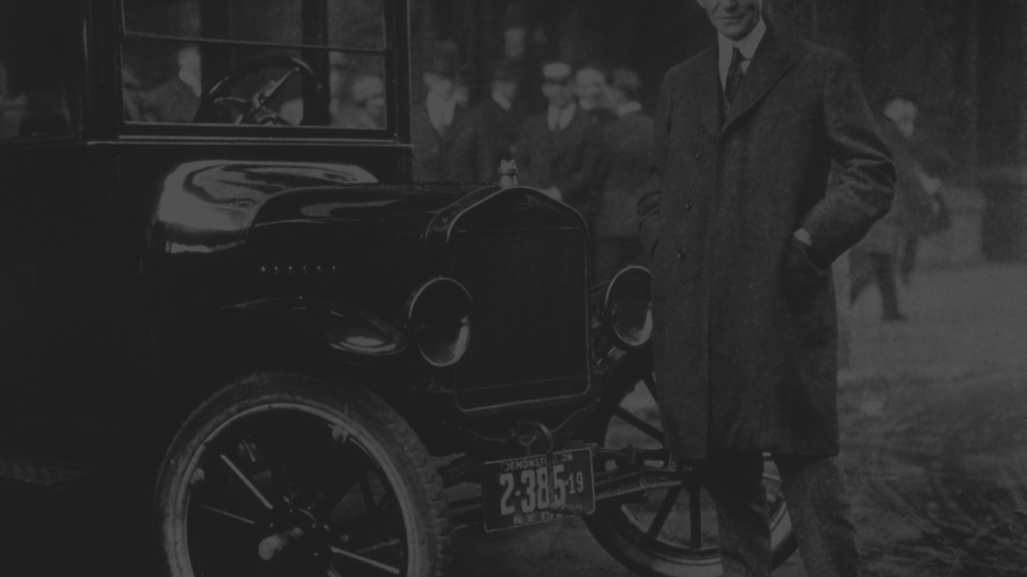
Closing Thoughts
Henry Ford's legacy as an entrepreneur and inventor is undeniable. From humble beginnings to changing the world with new ideas and innovative manufacturing methods, his contribution to the automotive industry, manufacturing and American society continues to inspire entrepreneurs and shape the world today.

