Slide 1
energy@venture
UNIT 1 - Fast Track
Reflections on the Climate Crisis, Energy and CO2

Slide 2
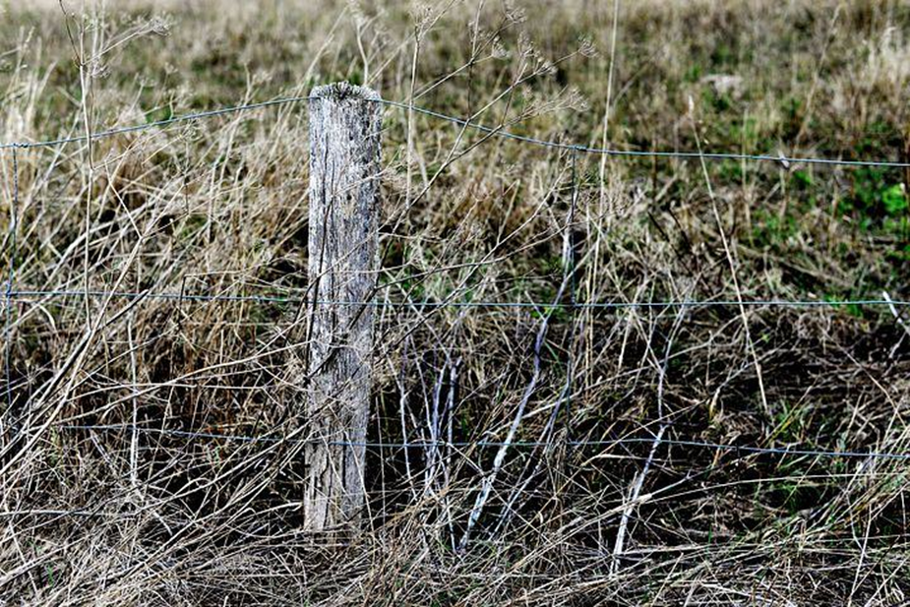
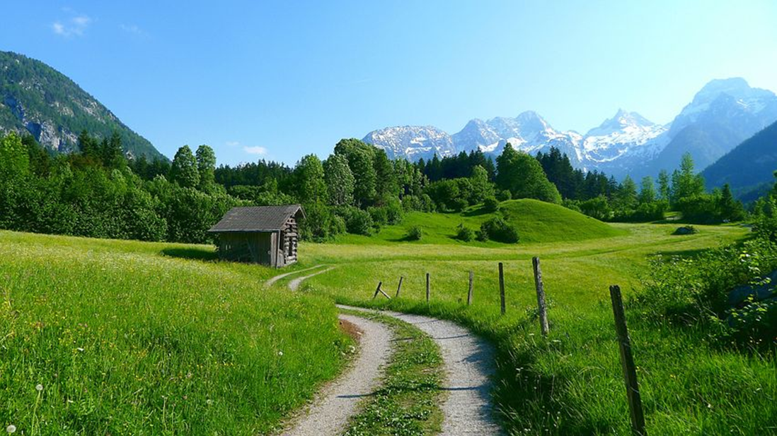
1.1 energy@venture Reflections on the Climate Crisis, Energy and CO2
In which world do you want to live?
Discuss: Which world do you like better? Why? Do you like other parts of Europe? What do they look like now? Will there be a change?

Slide 3
energy@venture
UNIT 2 - Fast Track
Understanding Climate Change
and Global Warming

Slide 4
1.2 energy@venture Understanding Climate Change and Global Warming
What is
Energy?
Why can’t it go on forever?
Jump for 30 seconds on one leg. Keep the other in the air!
Now, pause!
Change leg. Jump for another 30 seconds!
Look at the worksheet!
And try to answer the questions to this experience.

Slide 5
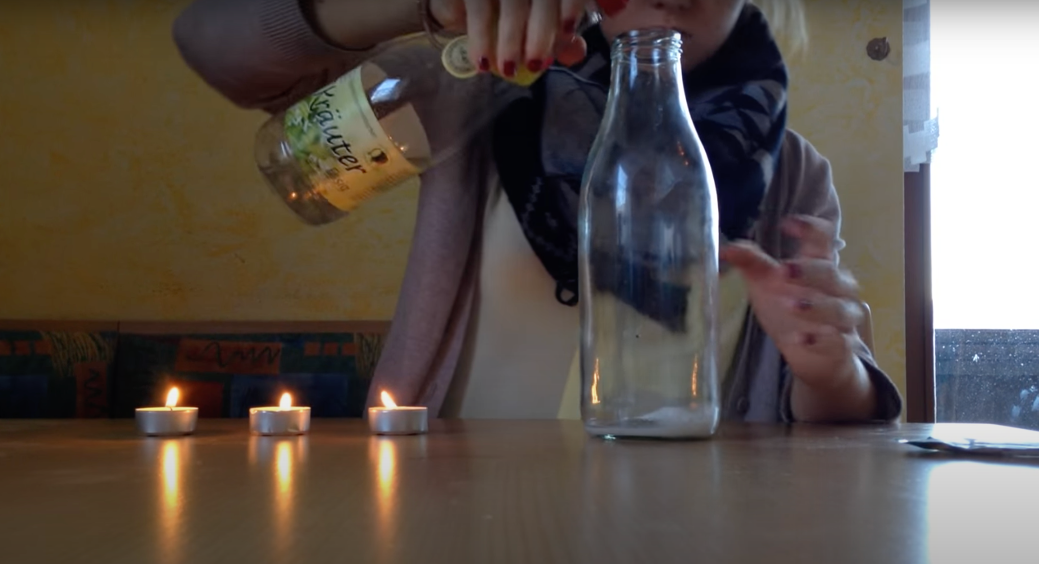
1.2 energy@venture Understanding Climate Change and Global Warming
How can you make an invisible gas visible?
You will use a trick to extinguish
a tea light - without blowing!
See instruction
on the worksheet

Slide 6
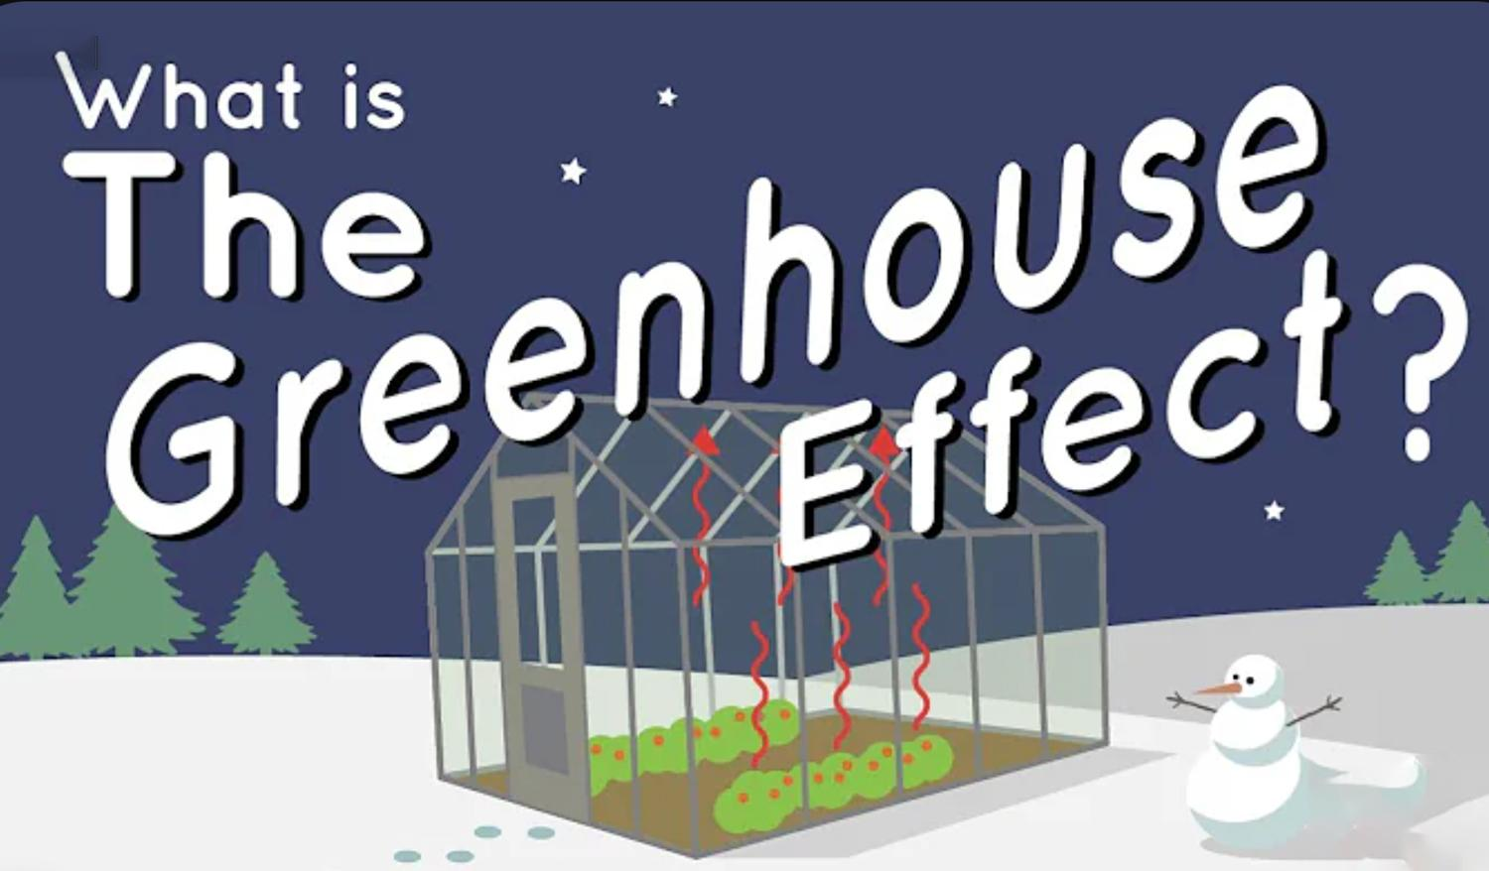
1.2 energy@venture Understanding Climate Change and Global Warming
Why is it warm
in a greenhouse?
Watch the video and then play a round of Jeopardy!
The greenhouse effect is a process that occurs when gases in Earth's atmosphere trap the Sun's heat. This process makes Earth much warmer than it would be without an atmosphere.
What Is the Greenhouse Effect?

Slide 7
i
energy@venture
UNIT 3 - Fast Track
What Is Scientific Storytelling?

Slide 8
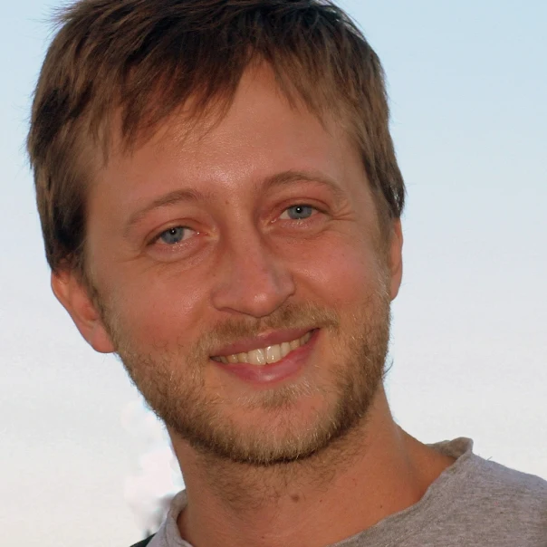
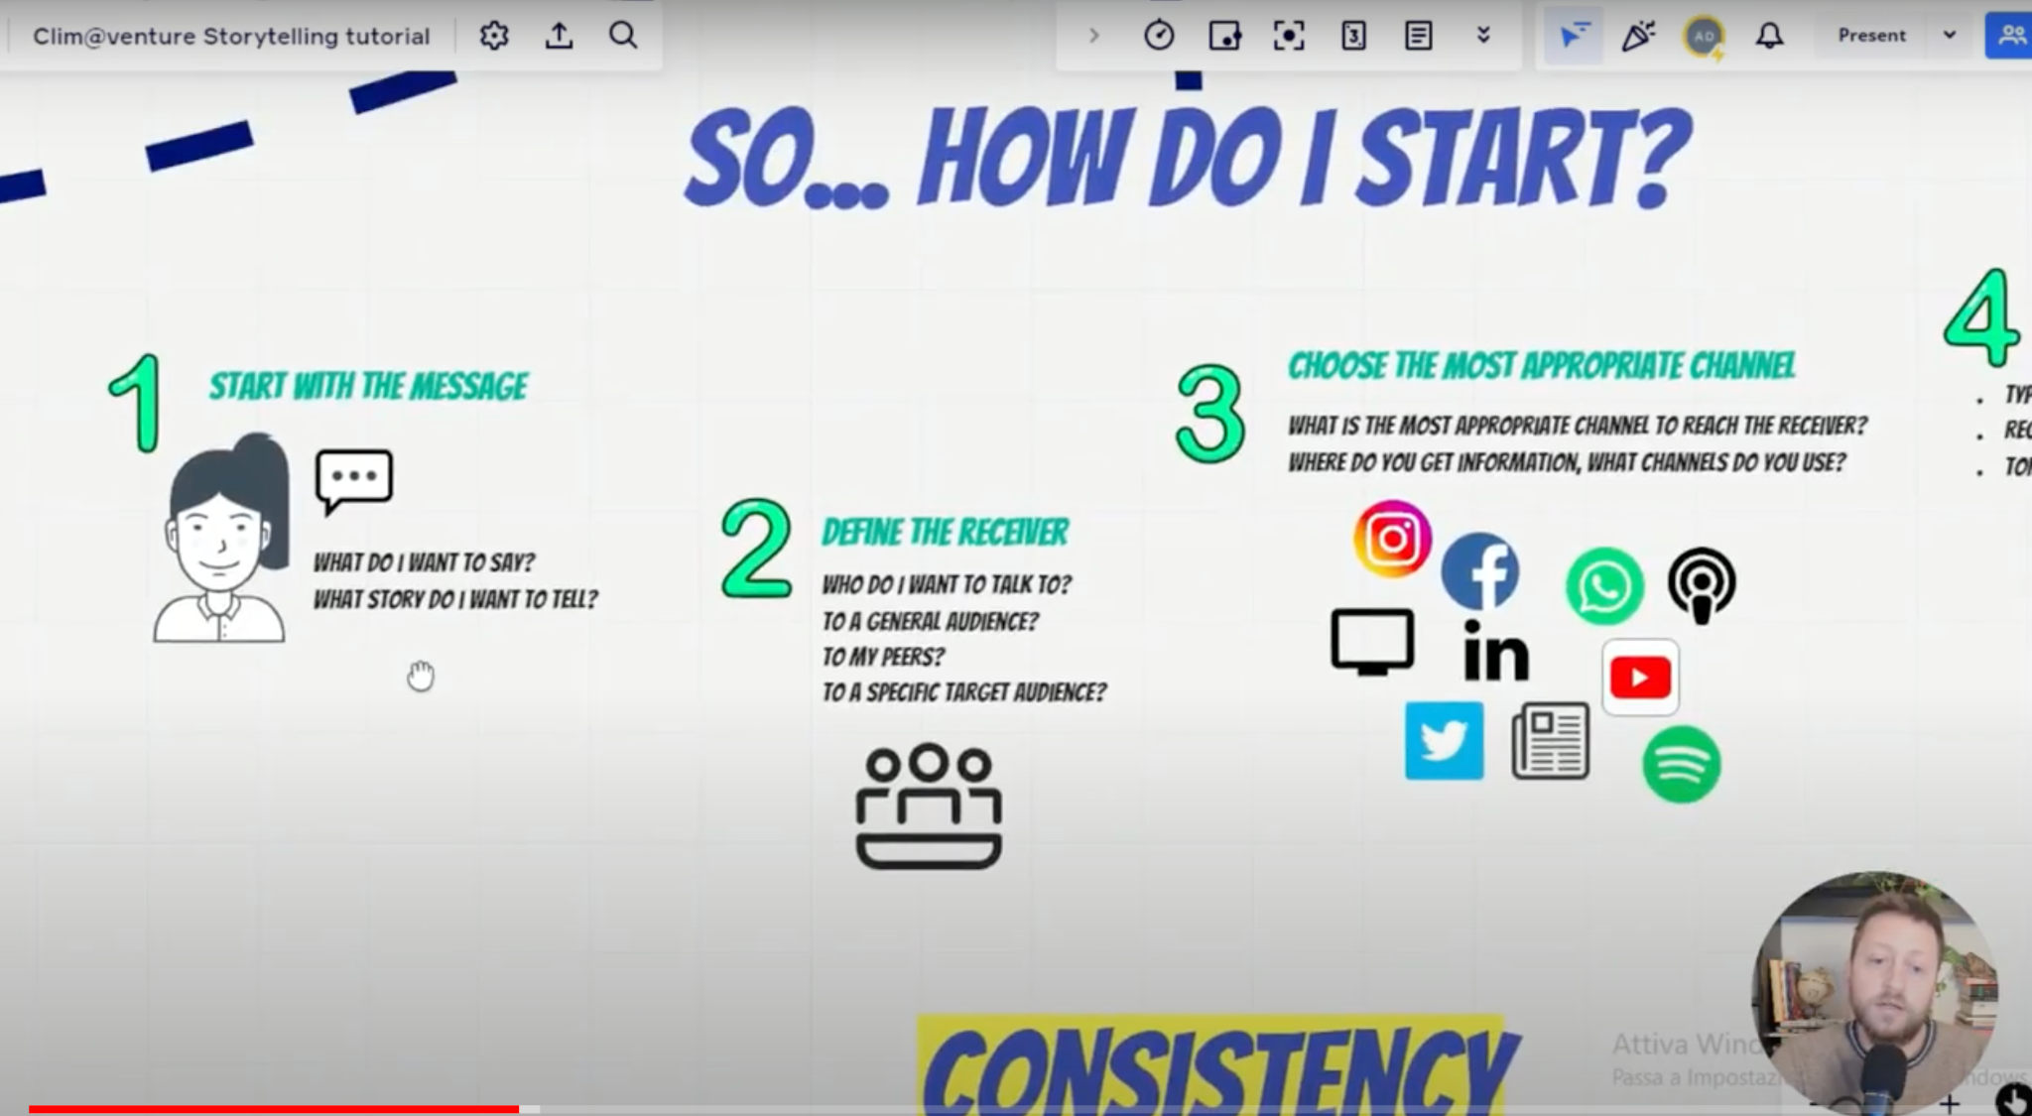
1.3 energy@venture What Is Scientific Storytelling?
Tutorial
How to tell
a scientific story
Andrea
Degl'Innocenti
Journalist expert on environment, economy, complex systems, governance models. A founding member of Italia che Cambia, he also collaborates with other newspapers including Il Manifesto, Terra Nuova, Nsl.

Slide 9
1.3 energy@venture What Is Scientific Storytelling?
Tools to create
a catchy video-story
It is not difficult, to create an inspiring video!
Watch this video tutorial and follow the links below for more inspiration.
▶️
How to Tell A Story In Video - Step by Step Script
Instagram Story Tools
Instagram Videos schneiden
🎞️
🎬

