Slide 1
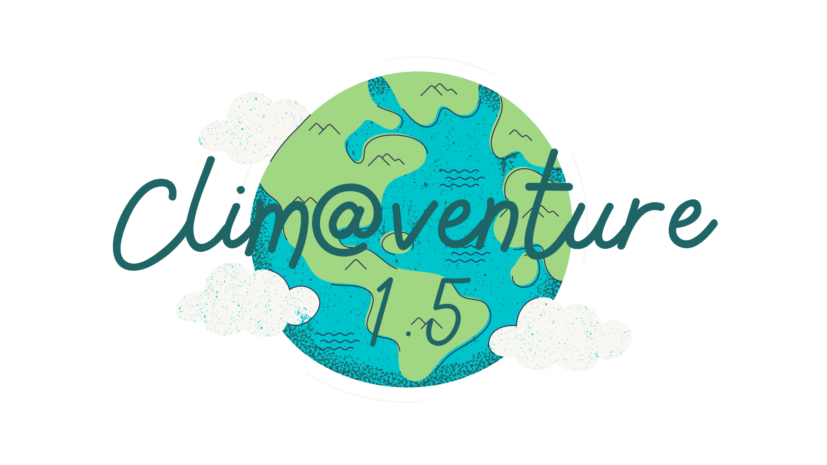
science@venture
UNIT 2 - Fast Track
Scientific Experimenting
and Documenting

Slide 2
2.1. science@venture scientific experimenting & documenting
Whatever You Do: Document It!
Sketch, take photos, make short videos, draw, mind-map, collect data, make notes, summarize, scribble, paint thought-bubbles, write down critical thoughts…
You need it for your story!
Image by macrovector on Freepik

Slide 3
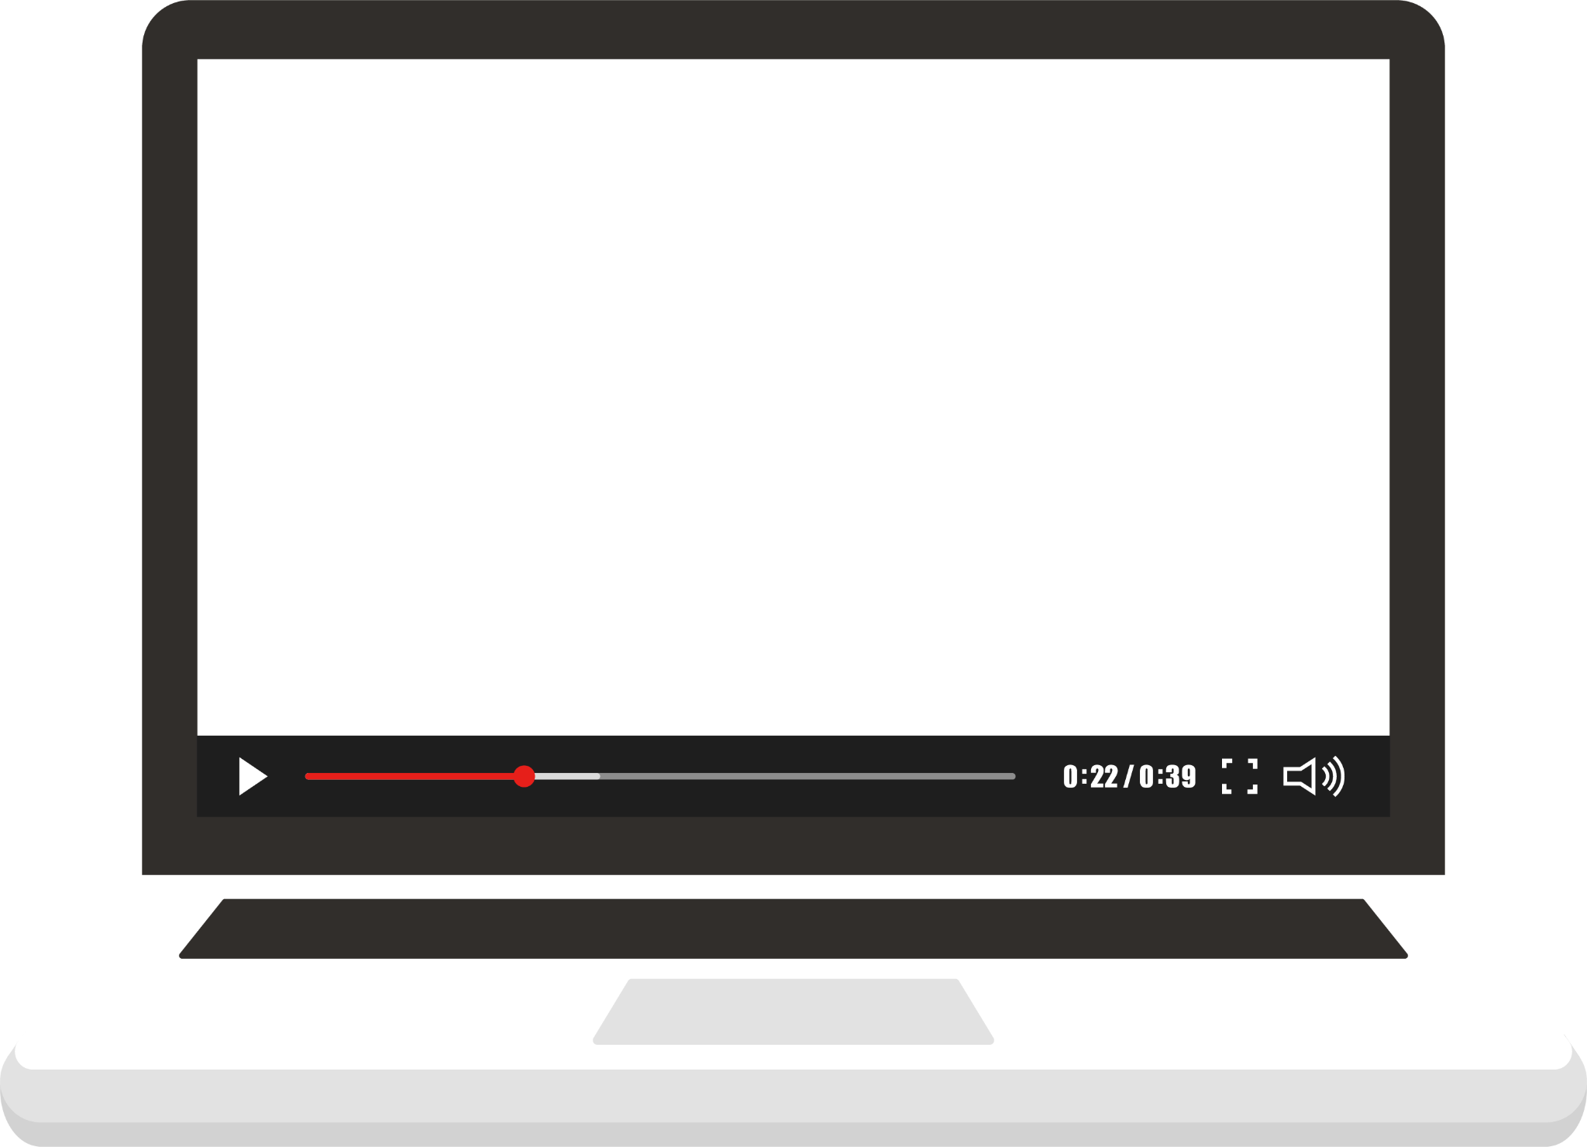
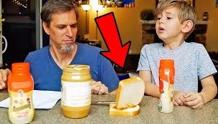
2.1. science@venture scientific experimenting & documenting
Read the “f.” manual
"EXACT INSTRUCTIONS" are not always as exact as the intend to be.
Watch the video!
Then you will see that you should not stop independent thinking, even if an instruction might be clearly written! Sometimes you have to guess a little bit what could be meant or include your own experience.

Slide 4
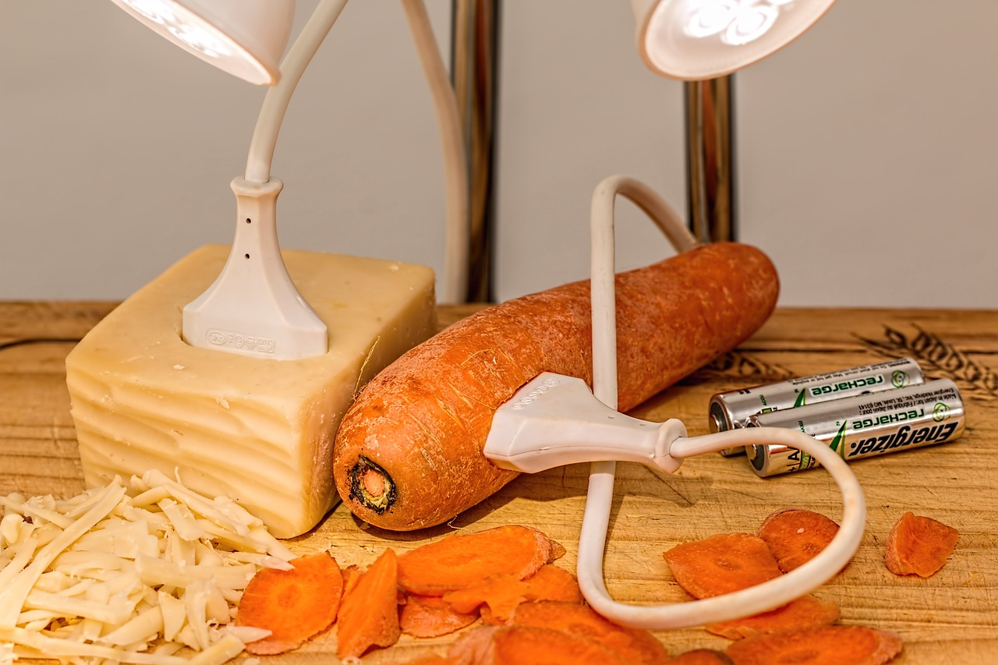
2.1. science@venture scientific experimenting & documenting
Prepared Surrounding - check what you need!
Who cleans up is just too lazy to look? A German proverb. And unfortunately not helpful when experimenting. Read the instructions for the planned experiments beforehand. Plan an extra time of about 50 % as a precaution. This is a rule of thumb: most of the time, everything takes twice as long as expected or planned! If you do this, you will know realistically how many experiments you can do in one session. Get all the materials or ingredients that are listed always at the beginning of the description of an experiment
👍
See the worksheet

Slide 5
science@venture
UNIT 2 - Fast Track
Six Climate Experiments

Slide 6
2.2. science@venture six climate experiments
Experience and Experimenting
2. What can a towel contribute to the fight against climate change?
5. Which diet is climate friendly?
3. Dress an ice cube warmly!
1. What has a black shirt to do with global warming?
6. How does your "shopping" or consumption affect climate change?
4. Green move. Move healthy and have fun!

Slide 7
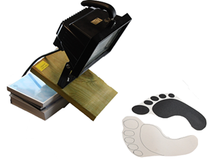
2.2. science@venture six climate experiments
1. What has a black shirt to do with global warming?
Albedo Effect
On a hot summer day, a white T-shirt stays cooler than a dark one. Light-coloured sand is less hot for the feet in strong sunlight and therefore more pleasant than black asphalt. This effect is called "albedo".
Experience this effect yourself and learn more about it!
👉
Learn more about Albedo Effect

Slide 8
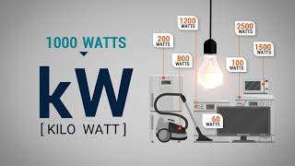
2.2. science@venture six climate experiments
2. What can a towel contribute to the fight against climate-change?
Consumption
of electric energy/current
Watch this video to get a first feeling of the costs (in Dollar) that causes use of electric devices.
How much energy do you think you can save if you pre-dry your hair with a towel?
👉
Learn more about energy consumption

Slide 9
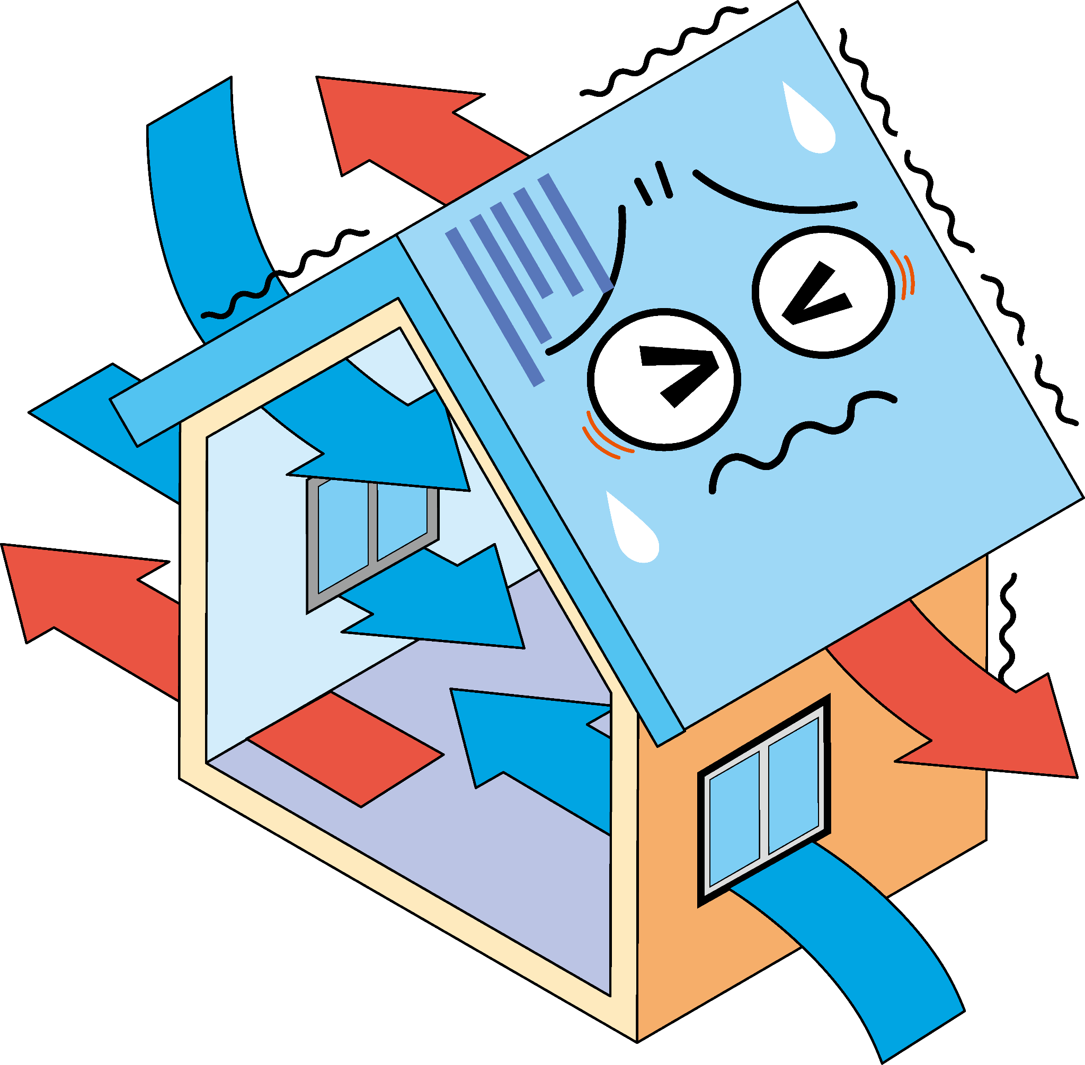
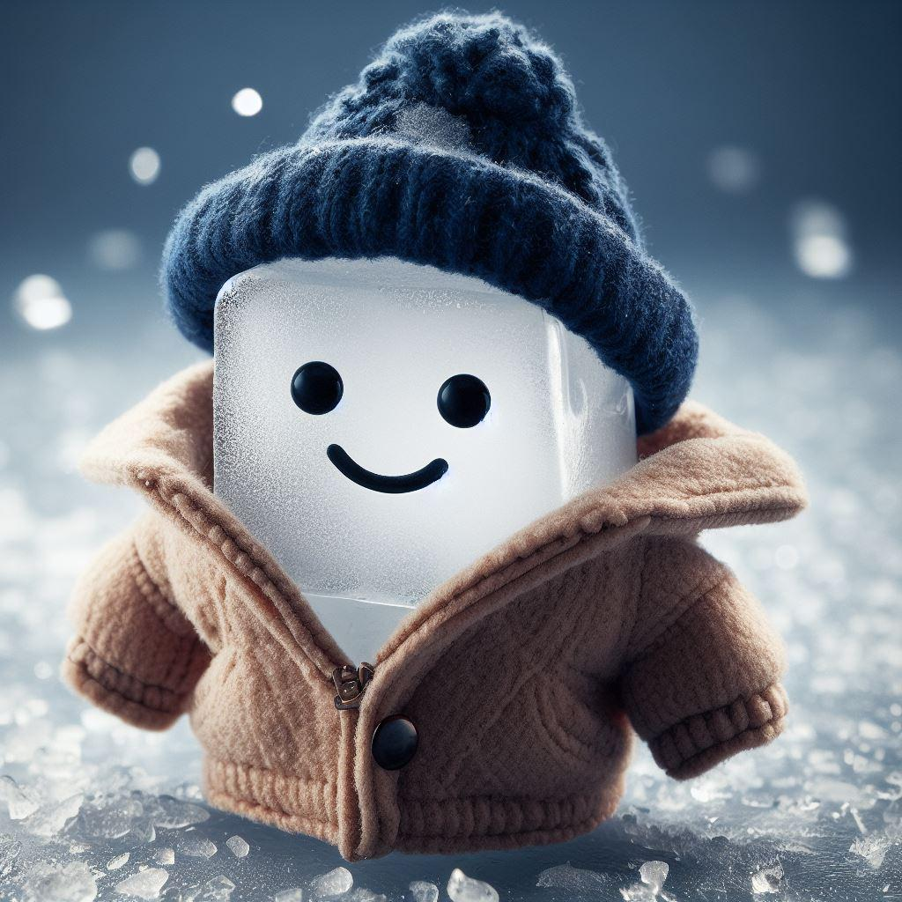
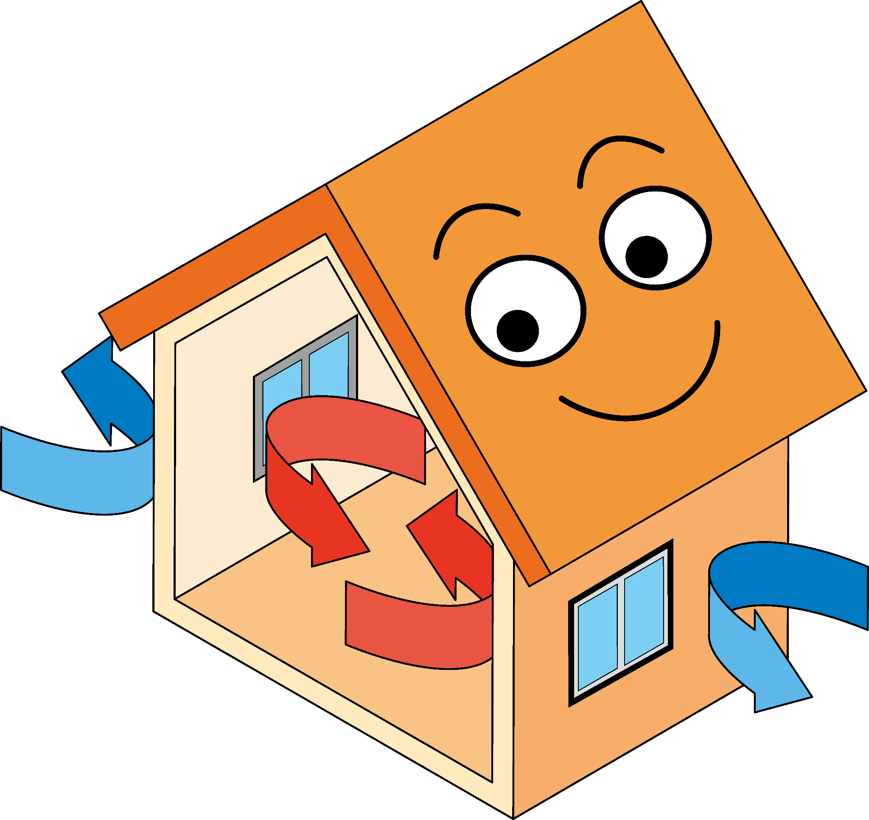
2.2. science@venture six climate experiments
3. Dress an ice cube warmly
Proper isolation
How much heat can be lost when heating and ventilating incorrectly? Investigate the effects of good insulation on heat loss.
👉
Use this funny challenge to make experiences!

Slide 10
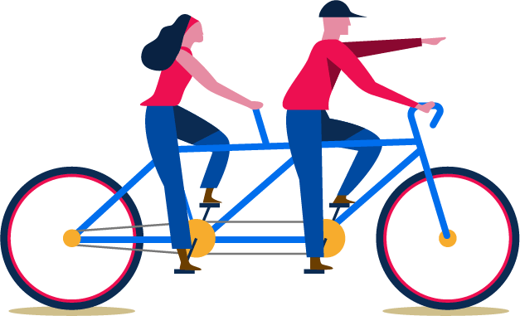
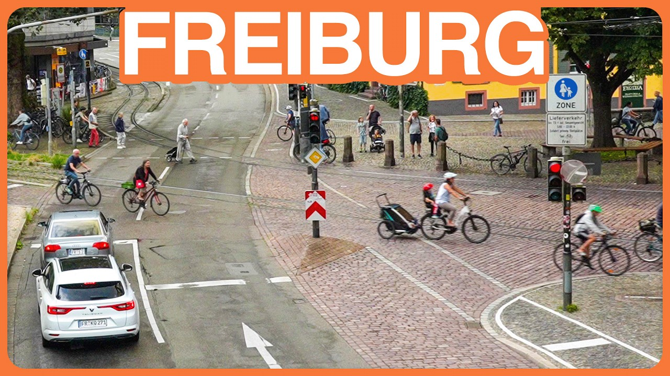
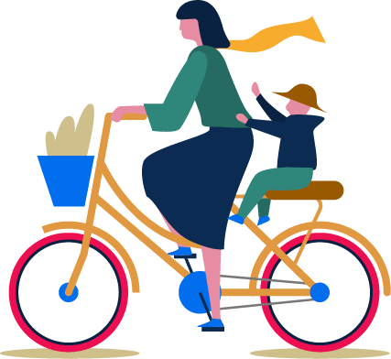
2.2. science@venture six climate experiments
4. Green move. Move healthy
and have fun!
Green mobility with fewer carbon dioxide emissions
For introduction and motivation, watch the video (at least the first 3 minutes).
Then create your own exciting experiences of energy consumption through physical exercise and calculations.
👉
Demonstrate the benefits of green travel here!
Images by pikisuperstar on Freepik

Slide 11
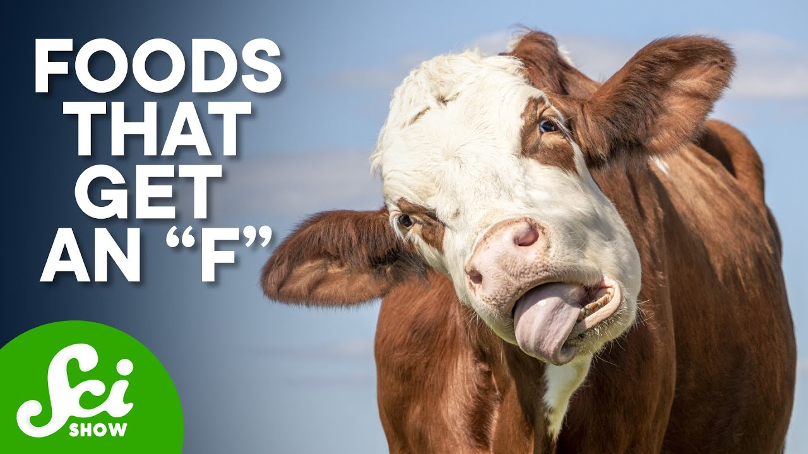
2.2. science@venture six climate experiments
5. Which diet is climate friendly?
👉
Get into action prepare a climate-friendly breakfast!
Relationship between food and carbon dioxide emissions
Watch this video first. It is not so easy as just stop eating dairy products…
First prepare a breakfast in class with food you have bought in advance.
Calculate the carbon footprint, water footprint, and land consumption rate of your breakfast. How climate-friendly did you choose your food

Slide 12
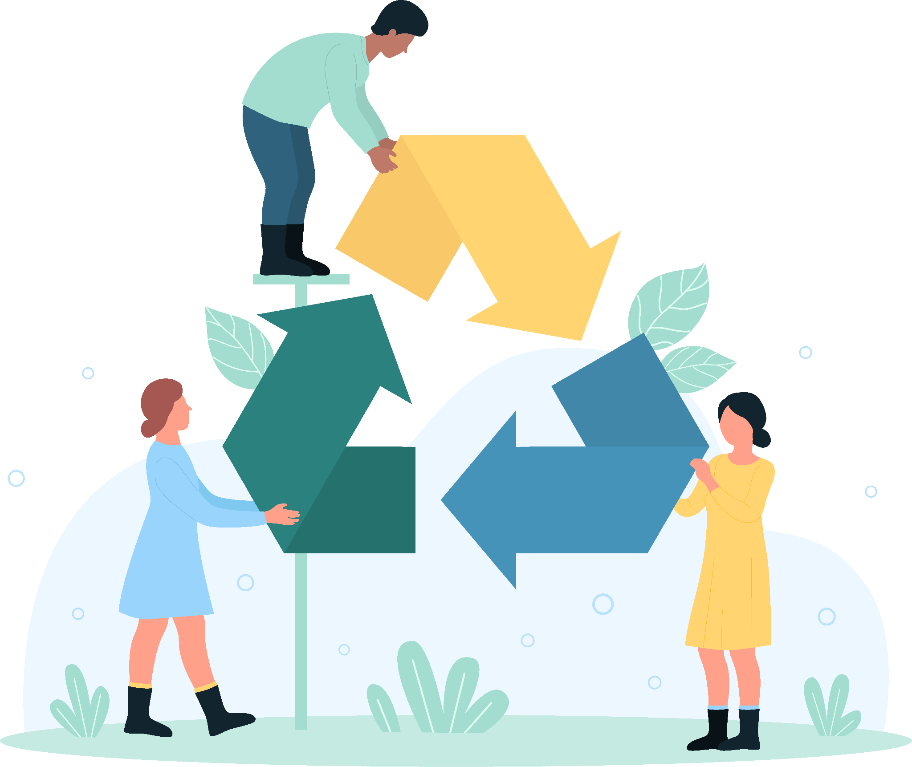
2.2. science@venture six climate experiments
6. How does your "shopping" or consumption affect climate change?
5 “rs” for a better world
re-duce
re-furbish
re-cycle
re-use
re-pair
👉
Experience here the impact our “ex and hop consumption” has on producers…
Share your experiences and feelings

Slide 13
science@venture
UNIT 3 - Fast Track
Shared Knowledge and Good Intentions

Slide 14
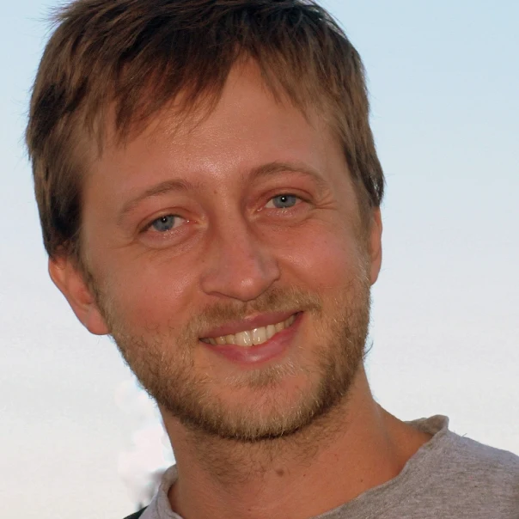
1.2 energy@venture Shared Knowledge and Good Intentions
Repetition of “constructive” journalism
If you haven't watched it yet: Here are some videos that will teach you the basics of constructive journalism. Look for an introduction at this Video by Andrea Degl'Innocenti. He is an journalist expert on environment, economy, complex systems, governance models.
Andrea
Degl'Innocenti
Storytelling Tutorial
How to do a good video or podcast

Slide 15
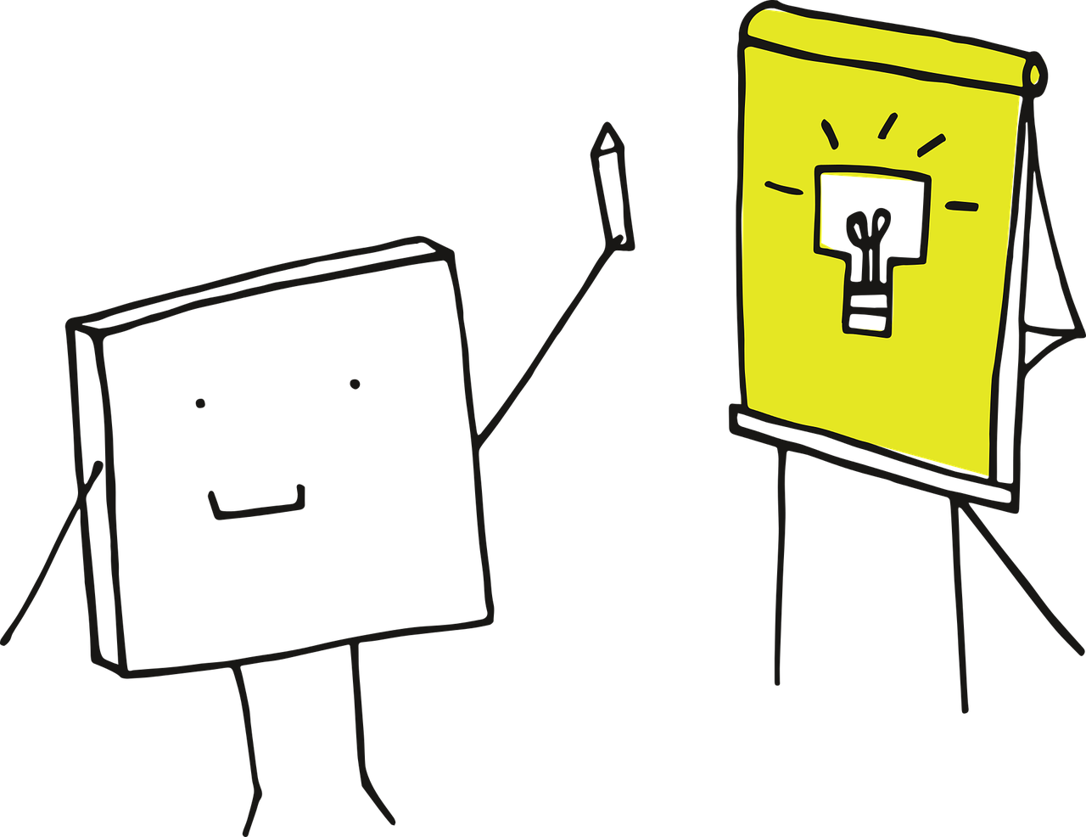
1.2 energy@venture Shared Knowledge and Good Intentions
Presentation of results
How to present results in PPT?
Train how to give a really short presentation - as an "elevator pitch". Your audience will thank you for it!
Then initiate a discussion: "Call to action": personal opportunities to become politically and socially active.

Slide 16
1.2 energy@venture Shared Knowledge and Good Intentions
Letter to yourself
“Dear (your name),
I found the experiments very interesting.
I have learned a lot and would like to live more environmentally friendly in some aspects. For example, I would like to eat vegetarian food at school. I would like to cycle to school in the summer. At least when it's nice and warm and not raining. I also want to buy fewer clothes because I regularly outgrow them anyway and then can't wear them any more.
Best wishes and see you in 4 weeks.
Yours (name)”
First part of a personal action-plan
Your teacher gives back your letters after a few weeks, and then you have a discussion and reflection

Slide 17
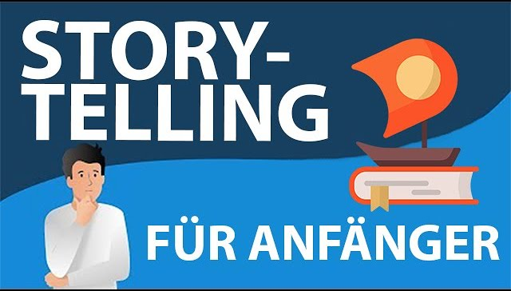
1.2 energy@venture Shared Knowledge and Good Intentions
Mnemonic Climate Change
A catchy sentence that summarizes one of the experiments well.
Ech word of the sentence on a separate large piece of paper (DIN A4).
A class to “perform” the sentence
“Walk the sentence” - in silence
Perform it like actors and actresses:
Emotionally, shouting, crying…
Make a song or a rap out of it…
How to tell a story in your raps
Elements of a story rap

Slide 18
1.2 energy@venture Shared Knowledge and Good Intentions
Climate Science-Show
Look out for examples
Activate fellow-scientists for your show
Design a setting: your type of scientist, media, place, tools, time-frame
Decide: who should be your audience?
Make sure there is someone who documents your show
Announce the show: inform headmaster/headmistress, use your school-website, inform teachers
Carry out your show
Produce a video from your show and spread it:
“all over the world”...
Watch the video

